Slide 1






How to use this deck
Overview
Name: Network Automation Workshop Deck
Purpose: This slide deck is part of a training course designed as an introduction to Ansible for network engineers and operators. The slides are meant to be taught in conjunction with hands-on exercises with a lab topology of Automation controller + 4 network devices.
Last updated: Sep 21, 2021 (check history for older versions)
What this deck is for? This deck corresponds to the prescriptive exercises available on https://ansible.github.io/workshops/exercises/ansible_network/ The upstream source for exercises and provisioner are provided on https://github.com/ansible/workshops
What this deck is not for? This is not a replacement for Red Hat training. This is a small “taste” of Ansible Automation Platform and meant to help people understand what is possible for network engineers with automation. Please refer to https://www.redhat.com/en/services/training-and-certification for official training
Google Slides source link (Red Hat internal): https://docs.google.com/presentation/d/1PIT-kGAGMVEEK8PsuZCoyzFC5CIzLBwdnftnUsdUNWQ/edit?usp=sharing
Notes:
Major aim
This deck is to support sales by catering to the interest of technical personas in the customer’s decision making process.
Why change from previous structure?
To enforce field to talk platform instead of Tower/Controller
To prepare for future changes (EE, Mesh, control plane)
To highlight value of technical details and not only the features themselves
Personas and their motivation
Technical (infra/network/security ops, but also developers; architects)
They want or need to understand the technology. They do not buy if they don’t have sufficient insight or big open questions.
Deck Strategy
Don’t just list technologies, regroup them by persona use case.
Show actual value along the technical details.
Target length: 60 minutes

Slide 2
Network Automation Workshop
Introduction to Ansible for
network engineers and operators
Notes:
Introduction to Ansible Automation Platform for System Administrators and Operators
During this presentation we will briefly cover our approach to automation and why Ansible Automation Platform, then dive into the value of this platform as it applies to your business context.

Slide 3
Timing
Breaks
Takeaways
Housekeeping
Understanding the format of this class
Notes:
This slide should give you time to gain the classes attention and set expectations for the day
Introduce yourself, relate with the audience. Tell them your background on either Ansible, Network Engineering or hopefully both depending on who you have to help you teaching the class
Feel free to fork this deck temporarily and add some slides to talk about yourself. You have to spend 4-6 hours with these folks so it's good to gain rapport with the audience
If the audience is small enough have them introduce themselves and what their role in the company is
If the audience is large do a “show of hands” to figure out the audience. It is very common that some folks show up for the wrong workshop despite personas being advertised.
The workshop is a pattern of slides-> hands on exercise, slides-> hands on exercise. Make sure the audience understands what they are covering for the day and how it is going to be covered.
Bathroom breaks most commonly happen when there is a break to complete exercise.
The instructor should DO THE EXERCISE on the projector / screen before each exercise to walk the students through their objective.
The instructor should WALK AROUND TO EACH STUDENT during the exercise breaks to make sure no one is stuck
If this workshop is an account specific workshop for one specific customer the account SA is encouraged to help teach and participate. The goal is to make network automation easy so that any SA at Red Hat can contribute to and deliver Ansible Network Automation workshops.
There is no test, quiz or exam for this workshop. The goal is to enable folks to understand what is possible, and how easy network automation is. Their main takeaway is where to find more resources and feel confident to run and build an Ansible Playbook and learn more.
More formal training is provided by Global Learning Services (GLS) and we have a 4 day network automation class: https://www.redhat.com/en/services/training/do457-ansible-network-automation

Slide 4



What you will learn
Introduction to Ansible automation
How Ansible works for network automation
Understanding Ansible modules and playbooks
Executing Ansible playbooks to make configuration changes
Gather information (Ansible facts)
Network Resource Modules
Using Automation controller to operationalize automation for your enterprise
Major Automation controller features - RBAC, workflows
Notes:
These are the options to get you started!

Slide 5

Ansible Network Automation Workshop
Introduction
Topics Covered:
What is the Ansible Automation Platform?
What can it do?
Why Network Automation?
How Ansible Network Automation works

Slide 6

Red Hat Ansible Platform technical deck
Automation happens when
one person meets a problem
they never want to solve again
Notes:
The “create” part of the platform is all about the content generation. To write the actual automation code which in the end will move the bits and pieces.

Slide 7







Many organizations share the same challenge
Red Hat Ansible Platform technical deck
Too many unintegrated, domain-specific tools
Network ops
SecOps
Devs/DevOps
IT ops
Notes:
There is an added challenge: in many IT teams it is common to have multiple domain- specific tools. Networking has its own tools. So does infrastructure. And security. These tools are rarely integrated with each other; and additionally, these teams are often isolated from other teams, meaning integration across the teams themselves is often limited if it exists at all.
The challenges don’t stop there: the people inside one team have different motivations, and different bases of knowledge. If you bring multiple teams together, perspectives can clash. A person who fills a persona in one team can fill a different persona in another team, such as an expert developer needing to consume some networking resources, or a security operations remediation workflow being managed by an IT operations specialist.

Slide 8



Why the Ansible Automation Platform?
Why the Red Hat Ansible Automation Platform?
Powerful
Simple
Agentless
Orchestrate complex processes at enterprise scale.
Simplify automation creation and management across multiple domains.
Easily integrate with
hybrid environments.
Notes:
So what is the Ansible Automation Platform, if not Ansible itself? The characteristics that make Ansible so popular are not only applied but extended by the Automation Platform.
The POWER of a single universal language across multiple technology domains.
The AGENTLESS model that allows seamless integration with a variety of technology platforms.
The SIMPLE nature of the Ansible Language to enable a broad selection of users to become functional in a short space of time.
And the platform enables an enterprise to operate and manage with Ansible at the scale, complexity and flexibility required by the modern enterprise.

Slide 9








Automate the deployment and management of automation
Why the Red Hat Ansible Automation Platform?
Your entire IT footprint
Do this...
Orchestrate
Manage configurations
Deploy applications
Provision / deprovision
Deliver continuously
Secure and comply
On these...
Firewalls
Load balancers
Applications
Containers
Virtualization platforms
Servers
Clouds
Storage
Network devices
And more ...
Notes:
What does that mean in tangible detail? What can you really do with the Ansible Automation Platform?
A lot, and across multiple domains:
Orchestrate fleets of VMs across the open hybrid cloud
Manage the configuration of networking devices across data centers
Enable application deployment to integrate load balancer changes and CMDB configuration
Enable developers to provision their own storage objects in an automated fashion when needed
Embed the automated configuration of external services into the CI/CD pipeline
Integrate firewalls with intrusion detection systems into streamlined security remediation workflows
Manage the lifecycle of existing applications and infrastructure, updating applications and hardware in streamlined processes

Slide 10




Break down silos
Red Hat Ansible Platform technical deck
Different teams a single platform
Consistent governance
Cloud
Edge
Datacenter
Line of business
Devs/DevOps
IT ops
SecOps
Network ops
Notes:
IT automation can bring the necessary change to tackle these challenges by...
integrating the different tools within siloed domains
streamlining processes across the tools
breaking down the silos between teams, integrating the various tools and processes across teams
establishing consistent governance of processes, products, and technologies
offering clear interfaces to provide and to consume resources as part of the automation
providing clear means to implement new processes and new content to extend the automation it self

Slide 11



What makes a platform?
On-premises
Ansible Cloud Services
Content creators
Automation controller
Automation
hub
Automation
services catalog
Insights for Ansible Automation Platform
Operators
Ansible content domains
Infrastructure
Cloud
Network
Security
Linux
Windows
Domain experts
Ansible command line
Users
Fueled by an open source community
Notes:
The architecture of the platform consists of a several core components, shown on the right, which are used by mentioned personas related to automation, indicated on the left.
Let’s have a closer look at the different parts, what they are made of, how they work with each other, from the perspective of the personas.

Slide 12
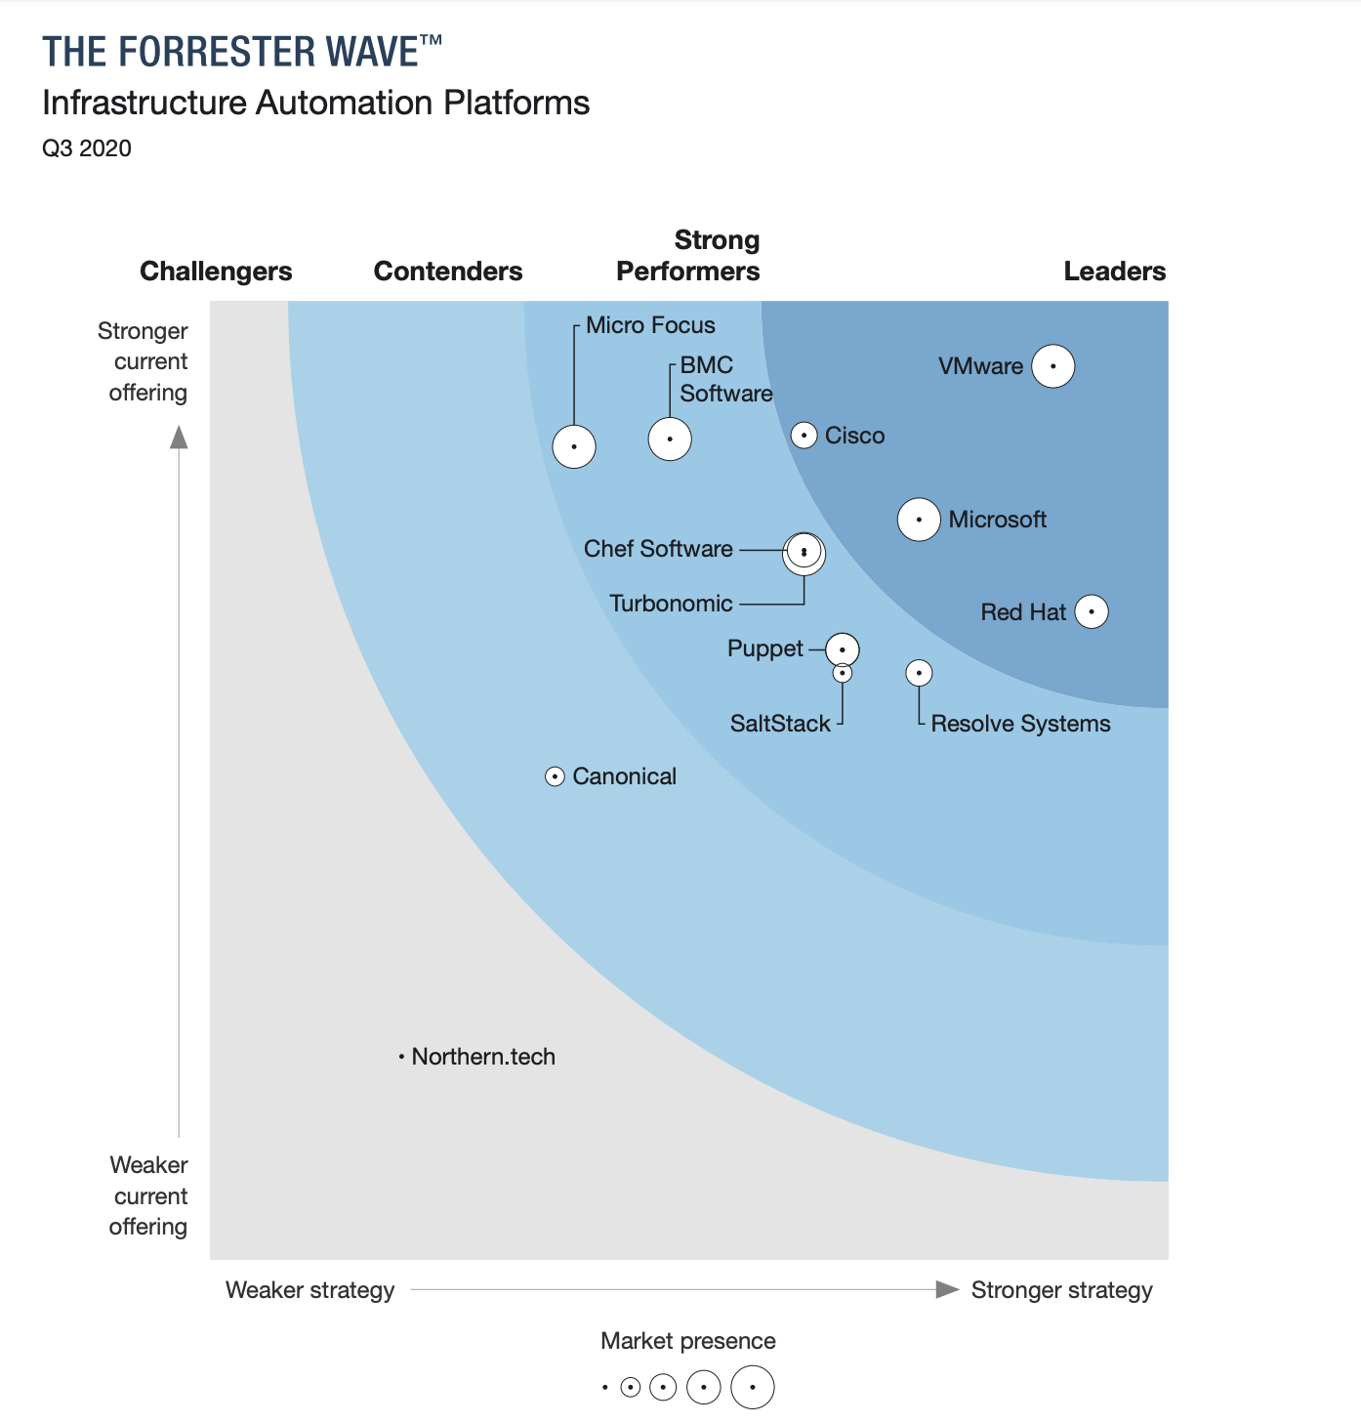

Red Hat named a Leader in The Forrester Wave™ Infrastructure Automation Platforms, Q3 2020
Automation and IT modernization
Received highest possible score in the criteria of:
Deployment functionality
Product Vision
Partner Ecosystem
Supporting products and services
Community support
Planned product enhancements
“Ansible continues to grow quickly, particularly among enterprises that are automating networks. The solution excels at providing a variety of deployment options and acting as a service broker to a wide array of other automation tools.”
“Red Hat’s solution is a good fit for customers that want a holistic automation platform that integrates with a wide array of other vendors’ infrastructure.”
Source:
Gardner, Chris, Glenn O'Donnell, Robert Perdonii, and Diane Lynch. "The Forrester Wave™: Infrastructure Automation Platforms, Q3 2020." Forrester, 10 Aug. 2020.
DISCLAIMER: The Forrester Wave™ is copyrighted by Forrester Research, Inc. Forrester and Forrester Wave™ are trademarks of Forrester Research, Inc. The Forrester Wave™ is a graphical representation of Forrester’s call on a market and is plotted using a detailed spreadsheet with exposed scores, weightings, and comments. Forrester does not endorse any vendor, product, or service depicted in the Forrester Wave™. Information is based on best available resources. Opinions reflect judgment at the time and are subject to change.

Slide 13
Ansible Network Automation Workshop
Use-Case
Network Automation
Notes:
divider slide…. easy time to take a break and check on class, we are now 10+ slides into the presentation

Slide 14

68%
of 77 respondents indicated they still use command line interface (CLI) on individual devices as the primary method of making network changes.
Source: Gartner, Market Guide for Network Automation and Orchestration Tools, September 2020
Notes:
For many network engineers, the command line is still a key management tool. But there are some things to consider:
Compute is no longer the slowest link in the chain
Businesses demand that networks deliver at the speed of cloud, and as we will see network complexity is on the rise again. Which means more to manage and so you need to be as fast and efficient as possible.
Automation considerations
Compute is no longer the slowest link in the chain
Businesses demand that networks deliver at the speed of cloud
Bridging Silos:
Network changes need to be made in the context of application/service deployment

Slide 15


Why hasn’t networking changed?
Networking vendors are the trusted advisors
PEOPLE
PRODUCTS
Domain specific skill sets
Vendor oriented experience
Siloed organizations
Legacy operational practices
Infrastructure-focused features
CLI-based interfaces
Siloed technologies
Monolithic, proprietary platforms
Notes:
Network operations really hasn’t changed that much in the last few decades. The engineers that design and manage networks are still largely doing it manually. What I mean by manually is just that – logging into a switch by hand, making changes to the running config, and then logging out. Many of the people that gravitated to network operations didn’t want to be programmers, they were more interested in implementing and maintaining network policies that were defined by the MOPs (Method of Procedure). With the rise of Linux and POSIX-based operating systems on the server side, the traditional proprietary networking methodologies continued to persist despite the rise of DevOps and open source. Regardless, it was only a matter of time until server-side and DevOps practices would invade the networking world with Cloud Administrators forced to support both the compute and network resources.

Slide 16





Next generation networking
Automation to effectively manage increasing diversity and scope
Edge / IoT Devices
Hybrid cloud
Digital transformation
Data-intensive computing
New device types entering networks at scale, with distributed computing.
Numerous deployment forms across the globe
Responding with new applications is only as fast as the slowest process
Artificial intelligence, digital applications and growing data driving connectivity
Notes:
But networking is at the point where managing from the command line is going to become unsustainable. Why is that? Networking is undergoing some big transformations.
Cisco in its 2020 networking global networking trends report, the evolving technology landscape is impacting network architectures and operations. For example, it predicts more than 700 million edge-hosted containers by 2021 and more than 14.6 billion IoT devices by 2022. You are probably well aware of the proliferating systems and implementations on the hybrid cloud and you also have data-intensive compute applications coming on board in the form of AI and machine learning. More computing as a result is going on outside the data center.
All of this is going to require more efficient management and this is where automation comes in to help you manage even more scope and even more complexity.

Slide 17






What is Ansible Network Automation?
Ansible network automation is our content domain focused on networking use cases. The goal is to provide network teams with the tools and an operational framework to implement next-generation network operations, manage network infrastructure-as-code, and better support digital transformation by connecting teams across the IT organization.
Ansible network automation is a set of Certified Content Collections designed to streamline and operationalize network operations across multiple platforms and vendors.
Load Balancers
Switches
.3
Controllers
Routers
Firewalls
IP Address Mgmt
Notes:
Ansible network automation is our Content Domain focused on networking use cases.
The goal is to provide network teams with the tools and an operational framework to implement next-generation network operations, manage their network infrastructure as code, and better support digital transformation.
Ansible network automation is a set of Certified Content Collections designed to streamline and operationalize network operations across multiple platforms and vendors.

Slide 18

Modernize and scale network operations
Choose what network tasks to automate at your own pace
TRADITIONAL NETWORK OPERATIONS
NEXT-GEN NETWORK OPERATIONS
Traditional culture
Risk averse
Proprietary solutions
Siloed from others
“Paper” practices, MOPs
“Artisanal” networks
Community culture
Risk-aware
Open solutions
Teams of heroes
Infrastructure as code
Virtual prototyping / DevOps
Notes:
And so, as we discussed, the network is getting even more complex. Most organizations are going to have to become more next-gen in their operations. Here are the characteristics of traditional and next gen network operations. Ansible Automation Platform will help you automate for the next generation.
The good news is that you can automate at your own pace. Perhaps you want to pick a task or two to start that are just time-consuming and rote and then progress from there. As you try to transform culture, you can start by getting rid of boring tasks and replace it with more interesting work which should be plentiful as you transform your network architecture.

Slide 19



What does it do?
Automate your network with a single tool
Configuration Management
Infrastructure Awareness
Network Validation
Platform agnostic configuration management to standardize and enforce best-practices.
Track network resources through facts gathering, to perform preventive maintenance, reducing outage risks and costs of unnecessary hardware-refresh.
Examine operational state to to check network connectivity and protocols and enhance operational workflows to help measure network intent.
Notes:
Ansible Automation Platform is highly flexible for automating any Network or IT use case and can automate across processes than involve multiple domains. So you can automate anything in your network, but here are three general areas where we see typically network automation.
-- configuration management to help you standardize configurations and enforce best practices
-- managing operational states, where you are gathering facts, doing maintenance, and ensuring uptime all more efficiently and at a lower cost.
-- compliance and traceability to keep audit trails of what changed when for a single source of the truth.
The benefit of Ansible Automation Platform is that it is a single tool you can use across the network instead of a range of vendor-specific automation tools. It can also be used across the architecture when you have multi-vendor network operational processes.

Slide 20








What is it for?
ansible.utils
OpenvSwitch
Pureport Fabric
F5 BIG-IP
F5 BIG-IQ
Cisco IOS Cisco NX-OS
Cisco IOS-XR
Nvidia Cumulus Linux
VyOS
VIRTUAL
NETWORKING
PHYSICAL
NETWORKING
SDN
CONTROLLER
Arista EOS
Juniper Junos
Infoblox NIOS
Dell OS9 Dell OS10 SONiC
CIsco ACI
Cisco DNA Center
Cisco NAE
Cisco MSO
A10 ACOS
Notes:
Here is a more detailed view. Ansible Automation Platform’s simple to use language means that you can automate across this vast array of physical networking devices. If there are a range of vendor-specific automation tools in place, you can use the Ansible language and platform to automate across these tools so you can automate a full network process with a single automation technology. If you do not have a range of vendor-specific network automation tools in place, then Ansible can automate tasks on this variety of physical networking devices as a single tool.
Let’s take a case of cross-domain automation, like deploying a new application. It may involve servers, storage, the network and more. Here again Ansible automates across all of this.
And for Ansible Automation Platform, there is a robust ecosystem of Certified Content Collections available to help you get new automation projects up and running faster through reusable, trusted automation content that also comes with support. Support may be required to meet certain compliance mandates and is just faster and easier if you encounter a problem.

Slide 21
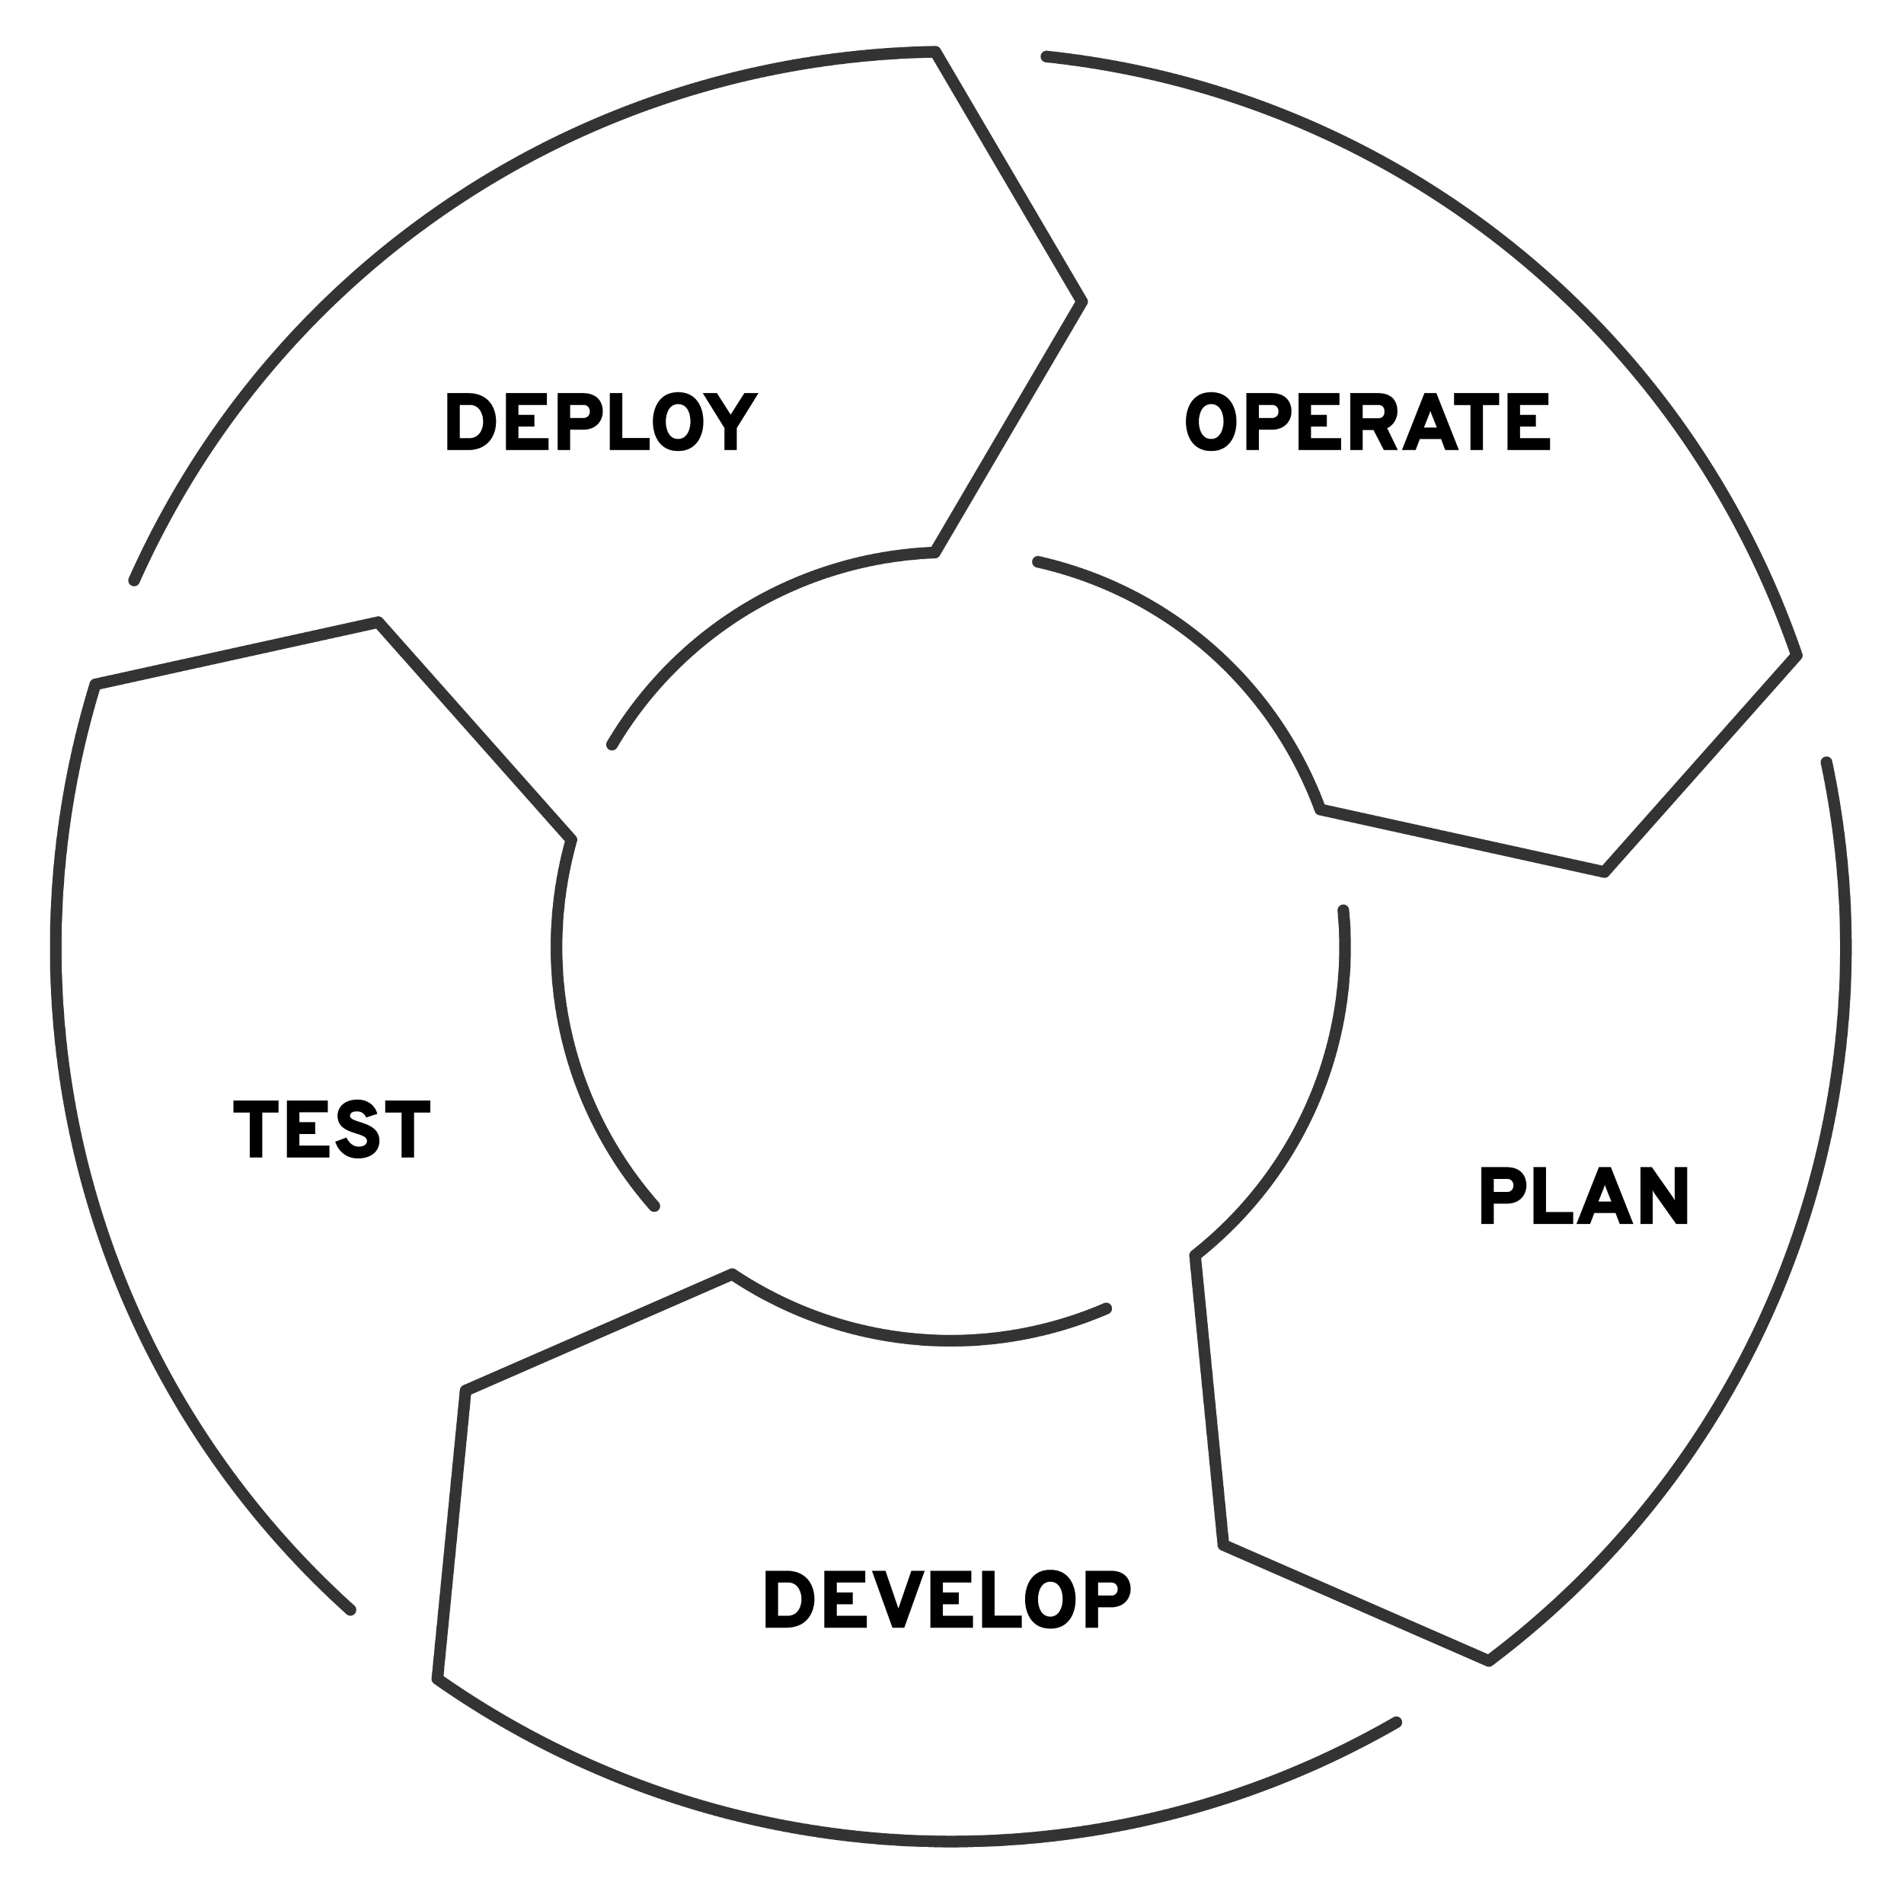
Start Small, Think Big
Three high-level benefits for successful network operations
Configuration Management
Automate backup & restores
Scoped Config Management
Infrastructure Awareness
Dynamic Documentation
Compliance and traceability
Network Validation
Validate operational steady-state
Roll back if configuration changes don’t meet goals
Notes:
How will you deploy? We advocate a “start small think big” approach. Pick some tasks and get started then grow from there. Some of the best early tasks could be simpler tasks that are repeated often. Here are some areas to consider, progressing from configuration management to infrastructure awareness to network validation as your automation skills and experience mature.
--- Additional speaker notes ---
I have already talked about picking some small rote tasks to automate and I stress that again here. Three things to keep in mind that automate can get you closer to infrastructure as code, since you would be using easy to read learn and use YAML to create and specify your playbooks.
For configuration management, your changes can be either incremental or wholesale and you can fit this into any type of process you currently use, whether it is agile, DevOps, NetOps, and IT service management approach, or traditional waterfall. In fact, we recently announced a certified content collection for ServiceNow that lets you update its Configuration Management Database (CMDB) whether you are responding to a service ticket or doing other tasks like maintenance. Instead of manually updating the CMDB, automation can put the updates in for you. This is a big deal when you are working with updates to hundreds of devices.
And finally to help ensure ongoing “resilient operations” you can schedule tasks on any schedule you want to do checking and validation without investing lost of staff time for this purpose.

Slide 22














Ansible Network Ecosystem
SWITCHES
ROUTERS
ENTERPRISE
FIREWALLS
LOAD
BALANCERS
CONTROLLERS
IP ADDRESS
MGMT
Notes:
The Ansible Network Automation Ecosystem is quite diverse in a number of different product categories. All of the supported modules can be found in Automation Hub on cloud.redhat.com and the automation content includes Ansible Playbooks, roles, modules and plugins distributed through Ansible Collections.
Ansible Network Automation can automate network switches and routers directly. There is automation content created specifically to automate routers and switches from network vendora Arista, Juniper, Cisco and others.
Automating enterprise firewalls is becoming increasingly popular since ACLs and firewall policies are changed often and prone to manual errors. Applying automation principals to firewall rules can decrease errors and improve efficiency. Popular firewalls like Checkpoint and the Juniper SRX are provided as well.
Controllers refers to network controllers. Ansible Automation Platform can “automate the automters”. So examples of this are Cisco ACI and NSO and Arista CloudVision. Network Controllers are very specific to a vendor, or even a specific category of equipment. Ansible Automation Platform can orchestrate and automate these into a robust holistic automation solution. This also means that network engineers don’t have to throw away existing automation. Ansible Automation Platform can fit these tools into its portfolio rather than compete with the directly.
Finally IP Address Management (IPAM) refers to tools like Infoblox DDI which can act as a source of truth for data we use to automate the network. For example the IP addresses we assign to network ports can be pulled from Infoblox dynamically.

Slide 23






Deep diving on use-cases
Configuration Management
Infrastructure Awareness
Network Validation
Config Backup and Restore
Dynamic Documentation
Operational State Validation
Scoped Config Management
Automated NetOps
Network Compliance
Notes:
Configuration Management
Platform agnostic configuration management to standardize and enforce best-practices.
Infrastructure Awareness
Track network resources through facts gathering, to perform preventive maintenance, reducing outage risks and costs of unnecessary hardware-refresh.
Network Validation
Examine operational state to to check network connectivity and protocols and enhance operational workflows to help measure network intent.

Slide 24


Network Automation Journey
OPPORTUNISTIC
SYSTEMATIC
INSTITUTIONALIZED
How can we simplify a task or set of tasks?
How do we centralise
our processes?
How do we orchestrate our processes?
• Backup & Restore
• Dynamic Documentation
• Scoped Config Management
• Network Compliance
• Operational State Validation • Automated NetOps
Complexity
Ansible Network Automation
Notes:
Crawl, walk, run
Low hanging fruits

Slide 25








Start Small
Quick automation victories for network engineers
✓
✓
✓
✓
Config Backup and Restore
Dynamic Documentation
Scoped Config Management
Ubiquitous first touch use case
• Gain confidence in automation quickly
• First steps towards network as code
• Quickly recover network steady state
Use Ansible facts to gain information
• Read-only, no production config change
• Dynamic Documentation and reporting
• Understand your network
Focus on high yield victories
• Automate VLANs, ACLs and SNMP config
• Introduce source of truth concepts
• Enforce Configuration policy
Notes:
Start small
Each of these use-cases will be expanded on in slides further down.
This slide it is important to note that automation is always a journey for a team or organization, and these three use-cases are very common for network engineer, architects and operators to begin their journey. The are high yield use-cases that allow network operators to see how much power Ansible can provide their team. We are well aware that there is a multitude of tools that exist for network automation. The reason that Ansible Network Automation is so important is that it bring a cultural change to network engineers and makes them think differently about the network and how the network exists within their IT infrastructure.
These use-cases are extremely simple, but incredibly powerful. As soon as network engineers start using some Ansible technology they will get addicted to the high yield return on their time and continue on to more advanced use-cases.
No network engineering team can fully realize return on investment until everyone on the team is onboard with network automation. Many organizations have a few people already using Ansible and the problem with adoption is not a technical one but a cultural one. By starting with small use-cases it allows everyone on a network engineering team to “win” and see why their automation subject matter experts might be frustrated that they are not doing more network automation.

Slide 26


Think Big
Institutionalizing automation into your organization
✓
✓
✓
Network Compliance
Operational State Validation
Automated NetOps
Respond quickly and consistently
• Security and config compliance for network
• Remove human error from security responses
• Enforce Configuration policies and hardening
Going beyond config management
• Parsing operational state to structured values
• Schema validation and verification
• Enhance operational workflows
Infrastructure as code
• Data centric automation
• Deploy configuration pipelines
• GitOps for Network Automation

Slide 27
Section 1
Ansible Basics
Ansible Network Automation Workshop
Topics Covered:
Understanding Inventory
An example Ansible Playbook
Notes:
divider slide…. easy time to take a break and check on class, we are now 10+ slides into the presentation

Slide 28
Create
The automation lifecycle
Ansible content experience
Build
Content creators
Red Hat cloud / on-premises
Discover
Automation hub
Ansible content domains
Trust
Infrastructure
Cloud
Network
Security
Domain experts
Linux
Windows
Notes:
At the core of each automation is the language itself - in which the content of the automation is written in. So we start with what the Ansible Automation language looks like, how it can be written - created - and how content written in the language is managed.
As part of this, we take the perspective of the people in charge of this: the domain experts who know all about the systems in question to be automated. They need to write - and maintain - code to automate the systems. And they have a need to store and maintain the code throughout the entire life cycle, aiding them in the development.
value: Companies writing their own automation scripts (bash, powershell, etc) have a huge, ever growing cost of maintenance for those, including an ever growing risk of problems and flaws. With a standardized language and integrations, maintenance cost comes down, and growth becomes manageable again.
example: in configuring Cisco switches: instead of customized bash scripts which are hard to read and harder to maintain and update, there are standardized, short playbooks leveraging the Cisco-written integration which can be read and understood by people not that familiar with Cisco. Or Bash.
Ending question: Let’s see what this actually looks like, what all the components mentioned here are and how they relate to each other.

Slide 29

Ansible playbooks
---
- name: install and start apache
hosts: web
become: yes
tasks:
- name: httpd package is present
yum:
name: httpd
state: latest
- name: latest index.html file is present
template:
src: files/index.html
dest: /var/www/html/
- name: httpd is started
service:
name: httpd
state: started
Notes:
Let’s start with a playbook example. As you can see it is rather short, and consists of three “tasks”; this playbook does three things.
The language itself is simple to grasp, and since each task carries a “name” statement, everything is already partially documented.
Value: Quick to learn, low entry barrier, and no developer skills needed.
Example: A network operations ops person can understand this, and read it. No need to train them on anything alien to their domain.
Ending question: So what are those “keywords” like yum and template? What is behind those, how do they work?

Slide 30



What makes up an Ansible playbook?
Plays
Modules
Plugins
Notes:
So what does a playbook consist of? There are three main pieces a playbook consists of: plays, modules and plugins. We will look at all components one by one in the next slides. There will be more questions down the line though: How to make playbooks reusable - and how to package and version control all mentioned components? This will be answered as well, stay tuned!
Ending question: So where do we start, what is a play?

Slide 31


Ansible plays
What am I automating?
---
- name: install and start apache
hosts: web
become: yes
What are they?
Top level specification for a group of tasks. Will tell that play which hosts it will execute on and control behavior such as fact gathering or privilege level.
Building blocks for playbooks
Multiple plays can exist within an Ansible playbook that execute on different hosts.
Notes:
A playbook is composed of one or more ‘plays’ in an ordered list. The terms ‘playbook’ and ‘play’ are sports analogies. Each play executes part of the overall goal of the playbook. The play usually defines which machines are affected by the keyword “hosts”. Also connection details are defined, here that the connection should use a privilege escalation via “become”. In the beginning it is not uncommon that a playbook only has one play.
Each play runs one or more tasks. Each task calls an Ansible module.
Ending question: What are the modules?

Slide 32

Ansible modules
The “tools in the toolkit”
- name: latest index.html file ...
template:
src: files/index.html
dest: /var/www/html/
What are they?
Parametrized components with internal logic, representing a single step to be done. The modules “do” things in Ansible.
Language
Usually Python, or Powershell for Windows setups. But can be of any language.
Notes:
What are modules? What they are made of?
They are parametrized components with internal logic, representing a single step to be done. The modules “do” things in Ansible.
Usually they are written in Python, or Powershell for Windows setups. But they can be of any language.
Value: Flexibility, just like lego building blocks, to write the automation step by step they need.
Example: If the need to automate certain tasks in VMWare, they just check out the modules they need, write them underneath, add the parameters, and are done.
Ending question: but are modules all that we have? Are there any other ways in which we can change the automation?

Slide 33
Ansible plugins
The “extra bits”
Example become plugin:
---
- name: install and start apache
hosts: web
become: yes
Example filter plugins:
{{ some_variable | to_nice_json }}
{{ some_variable | to_nice_yaml }}
What are they?
Plugins are pieces of code that augment
Ansible’s core functionality. Ansible uses a plugin architecture to enable a rich, flexible, and expandable feature set.
Notes:
There are plugins. Plugins are pieces of code that augment Ansible’s core functionality. Ansible uses a plugin architecture to enable a rich, flexible and expandable feature set. Ansible ships with a number of handy plugins, and you can easily write your own. Filter plugins are a good example of plugins. They can transform or format whatever was piped into the filter
Value: Extending the automation, providing interfaces to bring in additional or custom functions.
Example: If there is a custom authorization system on place, a become plugin might help to implement support for that in Ansible.
Ending question: But how do we avoid that every new user of Ansible starts to write a new playbook for something we already solved? If each team has an Apache server, how do we avoid that they all write “their” playbook to automate Apache?

Slide 34
Ansible Inventory
The systems that a playbook runs against
[web]
webserver1.example.com
webserver2.example.com
[db]
dbserver1.example.com
[switches]
leaf01.internal.com
leaf02.internal.com
What are they?
List of systems in your infrastructure that automation is executed against

Slide 35
Ansible roles
Reusable automation actions
---
- name: install and start apache
hosts: web
roles:
- common
- webservers
What are they?
Group your tasks and variables of your automation in a reusable structure. Write roles once, and share them with others who have similar challenges in front of them.
Notes:
Ansible roles allow creators to write their direct automation commands - sets of tasks, and also variables - in a reusable way. These can be shared with coworkers, with one team, or across an entire company to ease the adoption of automation, and also to define “official” (or “opinionated”) ways to automate certain components.
Value: Create shareable and reusable automation content. Don’t reinvent the wheel each and every time.
Example: There can be a role to properly set up and configure the PostgreSQL DB server. And a role to configure basic security means on all servers. And a role to properly configure all webservers.
Ending question: But where do roles, modules and plugins come from? How can we version this?

Slide 36






Collections
Simplified and consistent content delivery
What are they?
Collections are a data structure containing automation content:
Modules
Playbooks
Roles
Plugins
Docs
Tests
Notes:
Meet collections: a way to deliver content.
Can contain all kinds of automation content - most common are modules and “roles”, opinionated sets of playbooks to provide interfaces for typical use cases.
They are versioned, enable collaboration in development of content, can be easily distributed and also lower the barriers to automate existing solutions or products by providing pre-baked content.
Value: Collections can be used by partners, projects and also internal teams to write their content.
Example: F5 releases a new router firmware. They will update the modules of their collections so that those can work with the new firmware. Another example: IBM Qradar ships a new set of features which enables a new, multi step use case. The collection is updated with a role that enables to call the use case with only a few parameters.
Ending question: How does this look in real live?

Slide 37

Collections
deploy-nginx.yml
nginx_core
├── MANIFEST.json
├── playbooks
│ ├── deploy-nginx.yml
│ └── ...
├── plugins
├── README.md
└── roles
├── nginx
│ ├── defaults
│ ├── files
│ │ └── …
│ ├── tasks
│ └── templates
│ └── ...
├── nginx_app_protect
└── nginx_config
---
- name: Install NGINX Plus
hosts: all
tasks:
- name: Install NGINX
include_role:
name: nginxinc.nginx
vars:
nginx_type: plus
- name: Install NGINX App Protect
include_role:
name: nginxinc.nginx_app_protect
vars:
nginx_app_protect_setup_license: false
nginx_app_protect_remove_license: false
nginx_app_protect_install_signatures: false
Notes:
What are collections made of? Here we can see a directory layout for a collection, and that a playbook inside a collection is just one part.
Note that the collections keyword - like nginx_core here - is above all a ‘search path’: so that Ansible knows where to look for certain plugins, modules, etc, like the role “nginxinc.nginx_app_protect” in this example.
Value: Packaging, distributing and consuming the content is easy. Clear versioning and independent release cycles enable development of new content at the pace of the owners, not the overall community.
Example: Imagine you have a collection for your nginx core configuration. Using this collection, folks can simply reuse the main nginx stack in a secure, corporate-aligned way without thinking twice about how to do it themselves from scratch (let alone correctly).
Ending question: But where do we store, or get collections from?

Slide 38




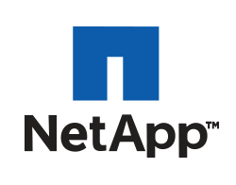

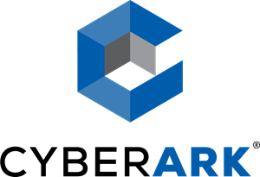





90+
Infrastructure
Cloud
Network
Security
certified platforms
Notes:
There are more than 90 Certified Content Collections, supporting over 30 technology partners and covering multiple different use cases.
What matters with automation is what IT organizations are aiming to accomplish, and Ansible’s Content Domain initiatives are designed to support real-world use cases across all the different pieces of an enterprise IT stack to help customers becoming productive faster and with a better return of investment. As part of the content domain we define use cases in the content domain, and get partners on board to provide certified content collections supporting the use cases in the content domains. We also communicate the use cases across partners, customers and community and provide enablement in form of focused documentation.
The Certified Content program provides co-support for partner developed modules making the Ansible Automation Platform the first automation platform on the market enabling end-to-end supported automation.

Slide 39
How is network automation different?
Ansible Network Automation Workshop
Notes:
divider slide…. easy time to take a break and check on class, we are now 10+ slides into the presentation

Slide 40


Network Automation compared to servers
Module code is executed locally on the control node
Network Devices / API Endpoints
Ansible Automation Platform
Local Execution
Linux / Windows
Hosts
Module code is copied to the managed node, executed, then removed
Ansible Automation Platform
Remote Execution
Notes:
In general, for non-network devices, Ansible modules are executed on the remote host versus being executed locally on the Ansible control node. Although some network platforms can execute Python code, the vast majority require the CLI or an API as the only means for interacting with the device. They are treated as an appliance versus a full operating system (even though many are running various versions of Linux or BSD operating system under the covers, this is not always exposed to the users)
The httpapi, network_cli and netconf connection plugins were created specifically for network devices. This allows playbooks to look, feel and operate just like they do on Linux hosts.
One question often comes up with how does this scale? (it would seem the remote execution method removes CPU from control node so it would scale better) Ansible module code is super lightweight so even in development environments hundreds of devices can be automated from very small CPU hosts (e.g. Sean’s laptop can automate a few hundred AWS IOS devices without blowing up), and as your automation increases Ansible Automation Platform can be installed onto a cluster to increase automation throughput. When using AAP on top of Openshift, it can leverage Kubernetes capacity to expand or contract automation capacity. This allows Ansible Automation to remain simple for users but expand for enterprise use-cases.
There is also the “job slicing” feature that allows an individual automation job to split its execution across multiple hosts within a cluster.

Slide 41
Network Connection Plugins
Use your vendor connection of choice
ansible_connection
netconf - XML over netconf example: Juniper Junos
network_cli - command line over SSH example: Cisco IOS-XE, Arista EOS
httpapi - vendor API example: Arista eAPI, Cisco NX-API
Arista EOS
httpapi
Cisco IOS-XE
network_cli
Juniper Junos
Ansible
Automation Platform
netconf
Red Hat Enterprise Linux
ssh
https://docs.ansible.com/ansible/latest/plugins/connection.html

Slide 42
Understanding Inventory
rtr1 ansible_host=18.220.156.59
rtr2 ansible_host=18.221.53.11
rtr3 ansible_host=13.59.242.237
rtr4 ansible_host=3.16.82.231
rtr5
rtr6

Slide 43
Understanding Inventory - Groups
There is always a group called "all" by default
[cisco]
rtr1 ansible_host=18.220.156.59 private_ip=172.16.184.164
[arista]
rtr2 ansible_host=18.221.53.11 private_ip=172.17.229.213
rtr4 ansible_host=3.16.82.231 private_ip=172.17.209.186
[juniper]
rtr3 ansible_host=13.59.242.237 private_ip=172.16.39.75
Groups can be nested
[routers:children]
cisco
juniper
arista
Notes:
Groups are created (wrt to INI format) square brackets [ ]
Groups can be nested using the keyword children

Slide 44
Understanding Inventory - Variables
Host variables apply to the host and override group vars
[cisco]
rtr1 ansible_host=18.220.156.59 private_ip=172.16.184.164
[arista]
rtr2 ansible_host=18.221.53.11 private_ip=172.17.229.213
rtr4 ansible_host=3.16.82.231 private_ip=172.17.209.186
[juniper]
rtr3 ansible_host=13.59.242.237 private_ip=172.16.39.75
[cisco:vars]
ansible_user=ec2-user
ansible_network_os=ios
ansible_connection=network_cli
Group variables apply for all devices in that group
Notes:
Groups are created (wrt to INI format) square brackets [ ]
Groups can be nested using the keyword children

Slide 45
A Sample Ansible Playbook
---
- name: configure VLANs
hosts: cisco
gather_facts: false
tasks:
- name: VLANs task
cisco.nxos.vlans:
config: - vlan_id: 5
name: WEB
- vlan_id: 10
A playbook is a list of plays.
Each play is a list of tasks.
Tasks invoke modules.
A playbook can contain more than one play.
Notes:
DO:
Walk them through what this module does (it configures the VLAN 5 with the name WEB, and vlan 10 without a name on any device in the group cisco,
DON’T
Do not dive too much into specifics, the next chapter will cover this with more detail (don’t spend 20 minutes on this slide, its meant to be easy!)

Slide 46
Lab Time
Exercise 1 - Exploring the lab environment
red.ht/network-workshop-1
In this lab you will explore the lab environment and build familiarity with the lab inventory.
Approximate time: 10 mins

Slide 47
Section 2
Executing Ansible
Ansible Network Automation Workshop
Topics Covered:
An Ansible Play
Ansible Modules
Execution Environments
Running an Ansible Playbook
Notes:
divider slide…. easy time to take a break and check on class, we are now 10+ slides into the presentation

Slide 48


Automation Execution Environments
Red Hat Ansible Platform technical deck: Create
Components needed for automation, packaged in a cloud-native way
Collections
Libraries
Ansible Core
Execution
Environments
Universal Base Image
Notes:
The components can be kept together in a typical way most of people are familiar with today: a standardized container! Meet the Automation execution environments: containers that only package the components needed for automation, packaged in a cloud-native way.
Value: Standardized, cloud native package containing all the components of the automation, including the dependencies and the core Ansible version. This all based on the tested and trusted RHEL Universal Base Image.
Example: AWS EE, containing the aws collection, the necessary AWS Python libraries and the Ansible version the team has already tested.
Ending question: Now we have the format to package and ship it in ways most people are familiar with. How do we actually built those?

Slide 49

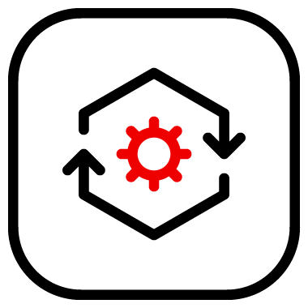

Build, create, publish
Development cycle of an automation execution environment
Collections
UBI
Dependencies
Content
Creator
Execution environment builder
Private automation hub
Ansible Core
Execution
Environment
Notes:
Building EEs is rather simple: we provide the tool execution environment builder, the CLI tool ansible-builder for this, which knows how to bring the pieces together in just the right way and create the EE. They can be published on Private Automation hub or in any container registry.
Value: Clear and simple tooling to let the creators focus on what they are best at: the automation content.
Example: The creators take the Check Point collection and dependencies and Ansible version, and just run ansible-builder. They don’t have to worry about Dockerfiles.
Ending question: And how do we run automation content with EEs? ansible-playbook was never written with containers in mind!

Slide 50


Develop, test, run
How to develop, test and run containerized Ansible content
Scalable
Content
Creator
Automation content navigator
Playbook
Execution
Environments
Supported
Notes:
How do you execute automation content when there are EEs in the background? Automation content navigator gives developers and creators a command-line tool to execute EEs on their development machines. Automation content navigator is discrete a Python application called ansible-navigator bundled with Ansible Automation Platform.
Challenge: Containerized execution introduces new challenges for developing, testing, and deploying Ansible content destined for Automation Controller*.
Value: Provides a more cohesive, more consistent, predictable, top-level developer experience for content destined to be run on the Platform. Leverages existing CLI knowledge while introducing enhancements due to containerized execution.
Example: The creator wrote a IBM cloud EE, and wants to quickly test it. ansible-navigator is the right tool.
Ending question: Now we discussed how to write all this automation content. But how do we run it, apart from developing and testing? Where is the enterprise scale?

Slide 51

Builder and Navigator
pull/create
Content Creator
ansible-builder
Execution Environment
execute
+
ansible-navigator
playbook
Execution Environment

Slide 52
Another Ansible Playbook Example
---
- name: snmp ro/rw string configuration
hosts: cisco
gather_facts: false
tasks:
- name: ensure snmp strings are present
cisco.ios.config:
lines: - snmp-server community ansible-public RO
- snmp-server community ansible-private RW
Notes:
don’t waste too much time on this slide, the next slide will break this down into easy chunks

Slide 53
Ansible Playbook - Play definition
The name parameter describes the Ansible Play
Target devices using the hosts parameter
Optionally disable gather_facts
---
- name: snmp ro/rw string configuration
hosts: cisco
gather_facts: false
Notes:
Explain that gather_facts will now work on ansible engine 2.9 and later

Slide 54
Modules
Modules do the actual work in Ansible, they are what gets executed in each playbook task.
Typically written in Python (but not limited to it)
Modules can be idempotent
Modules take user input in the form of parameters
tasks:
- name: ensure snmp strings are present
cisco.ios.config:
lines: - snmp-server community ansible-public RO
- snmp-server community ansible-private RW
Notes:
Modules and tasks have a 1 to 1 correlation. In this example the ios_config task is the module. The module documentation can be found here: https://docs.ansible.com/ansible/latest/modules/ios_config_module.html

Slide 55
Network modules
Ansible modules for network automation typically references the vendor OS followed by the module name.
namespace.collection.facts
namespace.collection.command
namespace.collection.config
namespace.collection.resource
More modules depending on platform
Arista EOS = arista.eos.
Cisco IOS/IOS-XE = cisco.ios
Cisco NX-OS = cisco.nxos
Cisco IOS-XR = cisco.iosxr
F5 BIG-IP = f5networks.f5_bigip_bigip.
Juniper Junos = junipsnetworks.junos.
VyOS = vyos.vyos.
Notes:
Most any network operation or configuration can be done with facts, command and config. Facts return structured data about the network device, commands run arbitrary commands on the network device (like show ip int br on a Cisco IOS device) and are not stateful (idempotent), and config modules allow configuration on the network device in a stateful (idempotent) way.
Some network vendors (e.g. Dell) choose to only support these three modules for their route/switch platform because almost any functionality can be done by just using facts, commands and config. Other network platforms have resource modules that configure a specific domain and/or activity on that device. For example the ios_vlan module will only configure VLANs on a newtork device

Slide 56

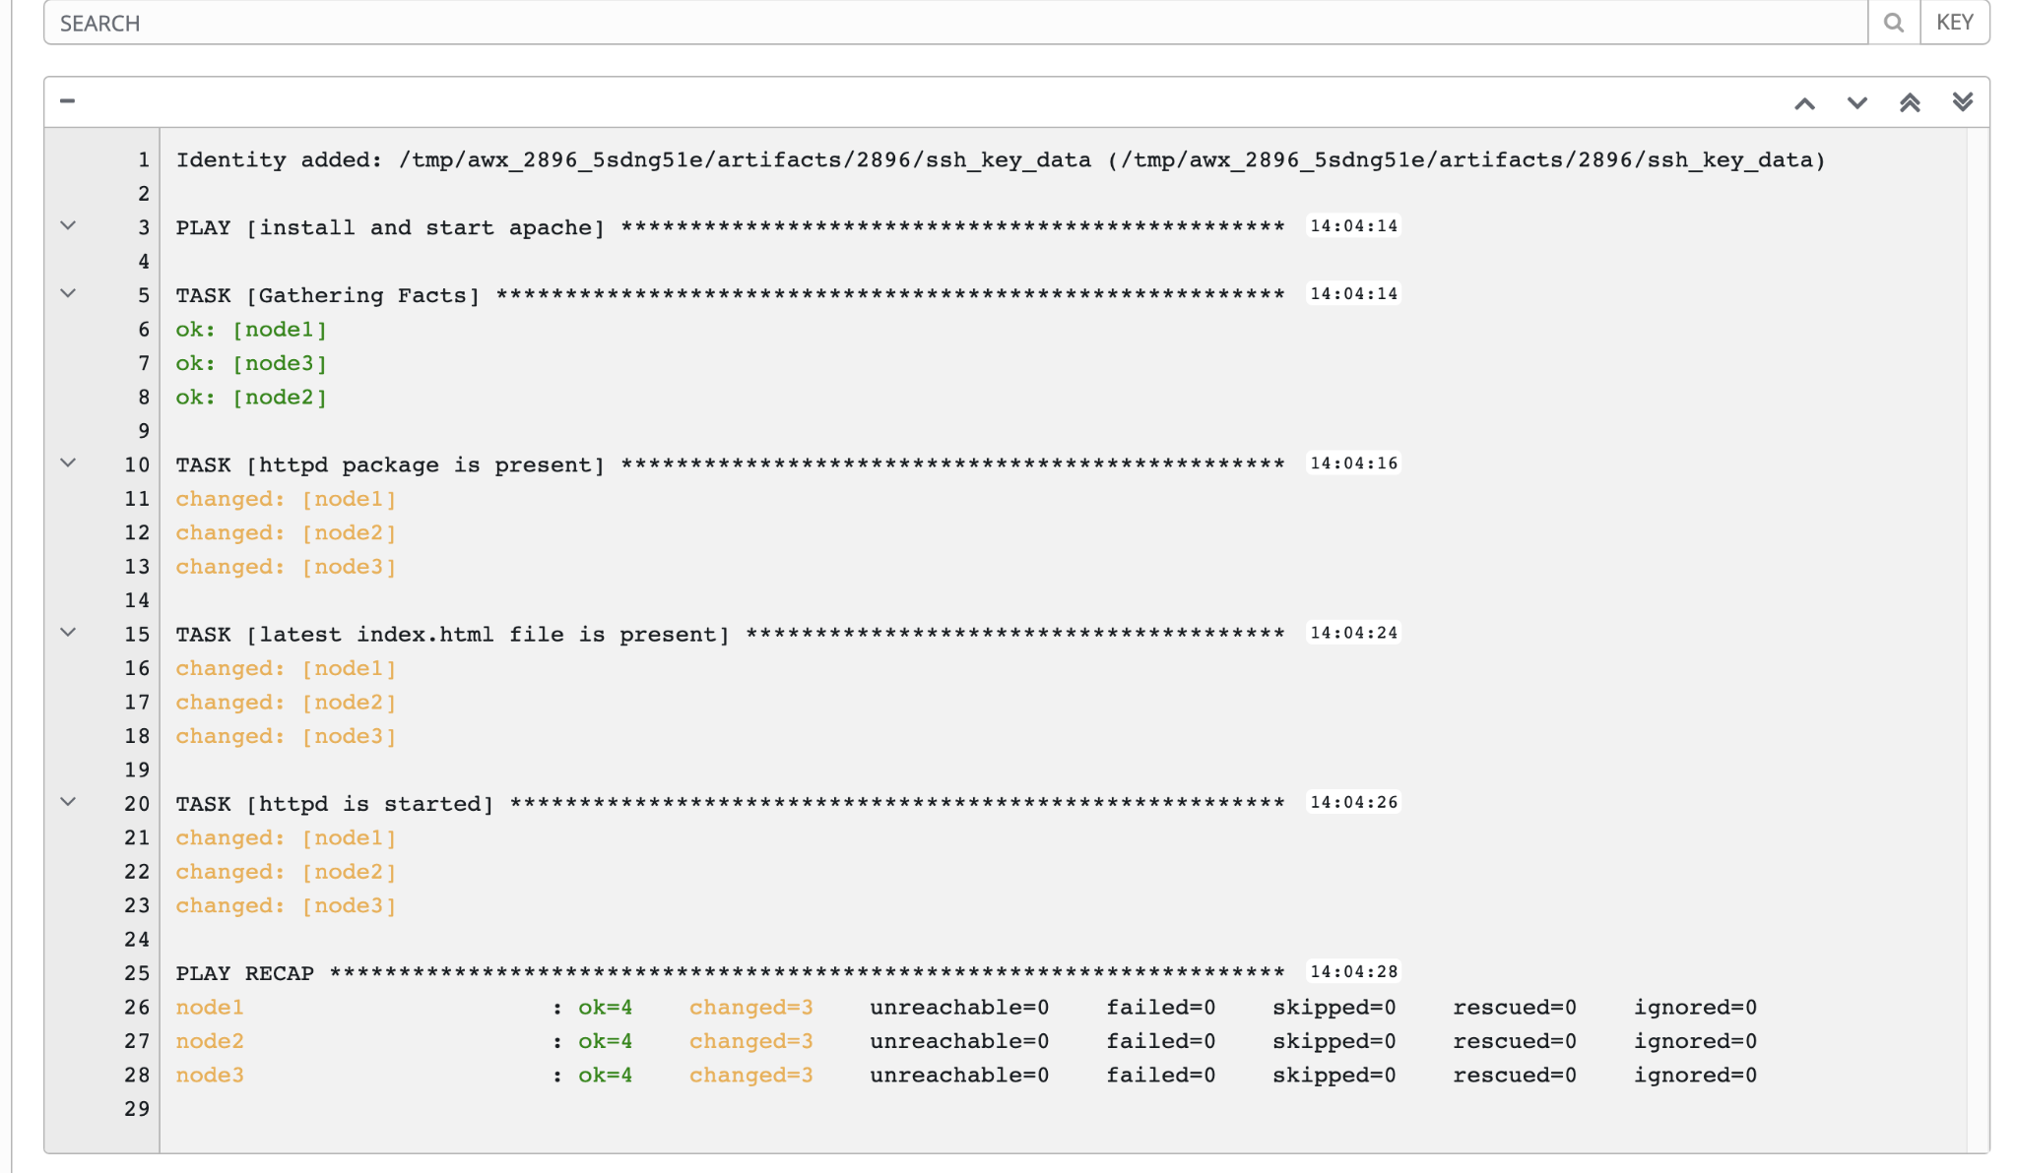
A playbook run
Where it all starts
A playbook is interpreted and run against one or multiple hosts - task by task. The order of the tasks defines the execution.
In each task, the module does the actual work.
Notes:
We start by executing the playbook from above, and run it against two hosts.
Playbook is interpreted, task by task (ordered execution).
In each task, a module does the actual work (as mentioned). Variables can be important here as well.
Each task has a name, which is the name field from each task in the playbook being run. This has the added advantage of understanding what is expected of each task.
Value: Clear and simple to follow execution pattern, easy to understand even with limited developer background
Example: A playbook to automate windows environments, first adding users to AD, ensuring policies, and then provisioning server nodes for these users to use in development.
Ending question: But where does the execution takes place in “real” setups? How to do we trigger, watch, monitor this execution?

Slide 57
Running an Ansible Playbook
Using the latest ansible-navigator command
$ ansible-navigator run playbook.yml
What is ansible-navigator?
ansible-navigator command line utility and text-based user interface (TUI) for running and developing Ansible automation content.
It replaces the previous command used to run playbooks “ansible-playbook”.
Notes:
Ansible navigator is the latest command line utility to run ansible playbooks. It is the replacement of the previously used command ansible-playbook. It introduces a text-based user interface in order to navigator through different parts of an Ansible playbook including the different takes run by the specific playbook.

Slide 58
ansible-navigator
Bye ansible-playbook, Hello ansible-navigator
# Direct command-line interface method
$ ansible-navigator run playbook.yml -m stdout
# Text-based User Interface method $ ansible-navigator run playbook.yml
How do I use ansible-navigator?
As previously mentioned, it replaces the ansible-playbook command.
As such it brings two methods of running playbooks:
Direct command-line interface
Text-based User Interface (TUI)
Notes:
The direct command-line interface can be used when the -m (mode) option is used to display the content in standard out. This would be a similar feel and experience as seen when running standard ansible-playbook in previous versions. The new TUI version is more interactive and makes it easier to navigate to specific tasks within your playbook. No more needing to scroll endlessly to find the result of what you are looking for.

Slide 59
ansible-navigator
Mapping to previous Ansible commands
ansible command | ansible-navigator command
ansible-config | ansible-navigator config
ansible-doc | ansible-navigator doc
ansible-inventory | ansible-navigator inventory
ansible-playbook | ansible-navigator run

Slide 60
ansible-navigator
Common subcommands
Name | Description | CLI Example | Colon command within TUI
collections | Explore available collections | ansible-navigator collections --help | :collections
config | Explore the current ansible configuration | ansible-navigator config --help | :config
doc | Review documentation for a module or plugin | ansible-navigator doc --help | :doc
images | Explore execution environment images | ansible-navigator images --help | :images
inventory | Explore and inventory | ansible-navigator inventory --help | :inventory
replay | Explore a previous run using a playbook artifact | ansible-navigator replay --help | :replay
run | Run a playbook | ansible-navigator run --help | :run
welcome | Start at the welcome page | ansible-navigator welcome --help | :welcome
Notes:
These are ansible-navigator subcommands that you may use when using the command utility. The CLI examples are what can be used directly within the terminal and the colon commands are to be used when you are within the TUI interface.

Slide 61
Running a playbook
---
- name: snmp ro/rw string configuration
hosts: cisco
gather_facts: false
tasks:
- name: ensure snmp strings are present
cisco.ios.config:
lines: - snmp-server community ansible-public RO
- snmp-server community ansible-private RW
[student1@ansible networking-workshop]$ ansible-navigator playbook.yml --mode stdout
PLAY [snmp ro/rw string configuration] ***************************************************************
TASK [ensure snmp strings are present] **********************************************
changed: [rtr1]
PLAY RECAP ********************************************************************************************
rtr1 : ok=1 changed=1 unreachable=0 failed=0 skipped=0 rescued=0 ignored=0

Slide 62
Displaying output
[student1@ansible networking-workshop]$ ansible-navigator playbook.yml --mode stdout -v
Using /home/student1/.ansible.cfg as config file
PLAY [snmp ro/rw string configuration] *****************************************************************
TASK [ensure that the desired snmp strings are present] ************************************************
changed: [rtr1] => changed=true
ansible_facts:
discovered_interpreter_python: /usr/bin/python
banners: {}
commands:
- snmp-server community ansible-public RO
- snmp-server community ansible-private RW
updates:
- snmp-server community ansible-public RO
- snmp-server community ansible-private RW
PLAY RECAP *********************************************************************************************
rtr1 : ok=1 changed=1 unreachable=0 failed=0 skipped=0 rescued=0 ignored=0
Increase the level of verbosity by adding more "v's" -vvvv

Slide 63
Lab Time
Exercise 2 - Execute your first network automation playbook
red.ht/network-workshop-2
In this lab you will use Ansible to update the configuration of routers. This exercise will not have you create an Ansible Playbook; you will use an existing one.
Approximate time: 15 mins

Slide 64
Section 3
Network Facts
Ansible Network Automation Workshop
Topics Covered:
Ansible Documentation
Facts for Network Devices
The debug module
Notes:
this section corresponds to exercise 3 in the lab guide https://ansible.github.io/workshops/exercises/ansible_network/3-facts/

Slide 65
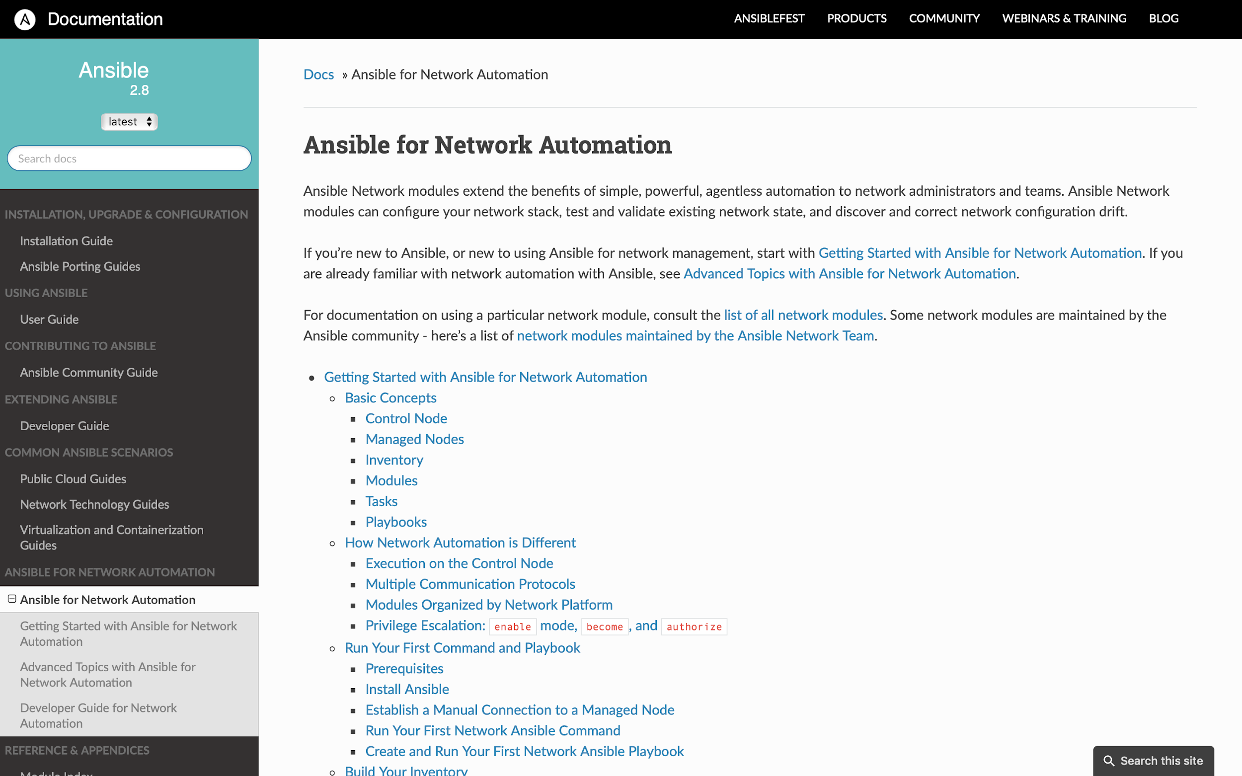
“Ansible for Network Automation” Documentation
red.ht/NetworkDocs
Notes:
https://docs.ansible.com/ansible/latest/network/index.html
Specific Network Automation Section for Ansible including a getting started guide

Slide 66
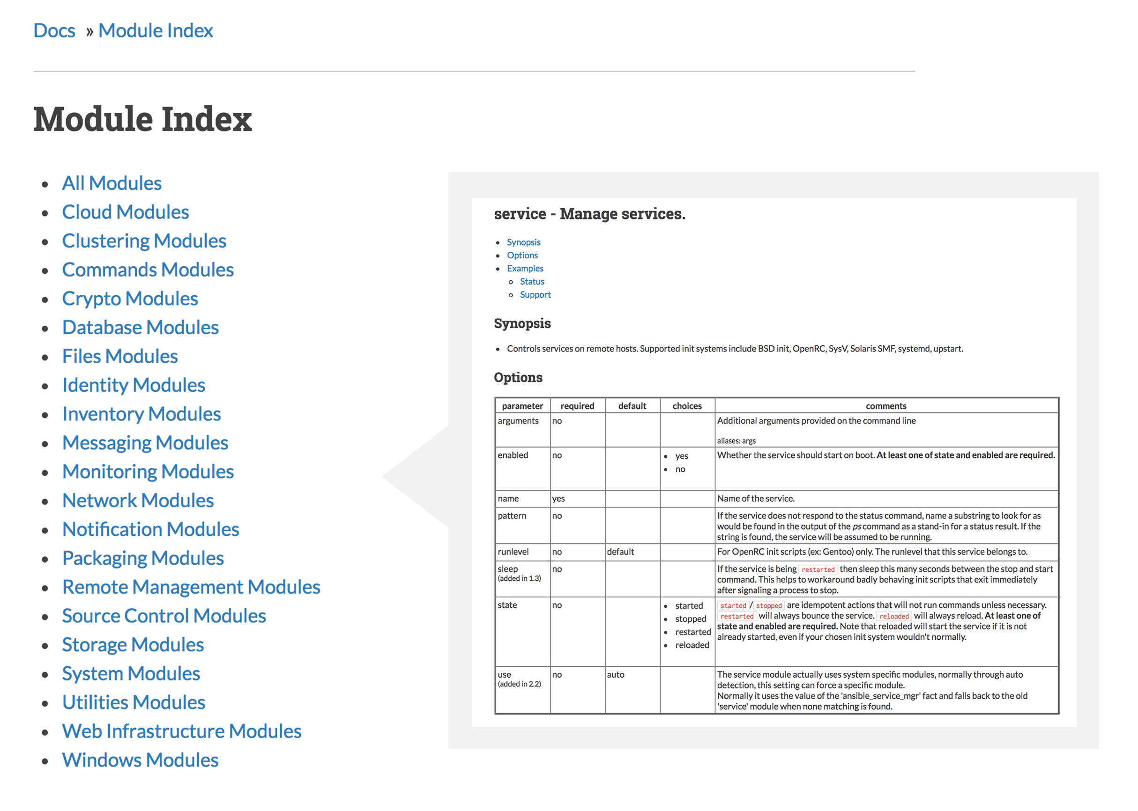
Module Documentation
Documentation is required as part of module submission
Multiple Examples for every module
Broken into relevant sections
https://docs.ansible.com/

Slide 67
Accessing the Ansible docs
$ ansible-navigator doc -l -m stdout
add_host
amazon.aws.aws_az_facts
amazon.aws.aws_caller_facts
amazon.aws.aws_caller_info
.
.
.
.
.
With the use of the latest command utility ansible-navigator, one can trigger access to all the modules available to them as well as details on specific modules.
A formal introduction to ansible-navigator and how it can be used to run playbooks in the following exercise.

Slide 68

Fact modules
Arista EOS
arista.eos.facts
Cisco IOS
cisco.ios.facts
Juniper Junos
junipernetworks.junos.facts
Notes:
Fact modules are unique per platform. For Cisco IOS-XE you would use ios_facts, for Juniper Junos you would use junos_facts and so on and so forth.
Fact modules return structured data of important device information such as IP addresses, software version, interface names and much more.

Slide 69
What are facts?
Structured data, the Ansible way
cisco# show version
Cisco IOS XE Software, Version 16.09.02
Cisco IOS Software [Fuji], Virtual XE Software (X86_64_LINUX_IOSD-UNIVERSALK9-M), Version 16.9.2, RELEASE SOFTWARE (fc4)
Technical Support: http://www.cisco.com/techsupport
Copyright (c) 1986-2018 by Cisco Systems, Inc.
<<rest of output removed for slide brevity>>
cisco# ansible -m ios_facts cisco cisco | SUCCESS => {
"ansible_facts": {
"ansible_net_iostype": "IOS-XE",
"ansible_net_version": "16.09.02",
"ansible_net_serialnum": "9L8KQ482JFZ",
"ansible_net_model": "CSR1000V",
<<rest of output removed for slide brevity>>
Cisco IOS output
Ansible output
Notes:
With Ansible you can retrieve or discover certain variables containing information about your remote systems or about Ansible itself. Variables related to remote systems are called facts.
Facts are structured data (key, value pairs) that we can know about the network devices.
More info on facts can be found here: https://docs.ansible.com/ansible/latest/user_guide/playbooks_vars_facts.html#vars-and-facts

Slide 70

Ansible Automation Platform facts
Network automation begins and ends with facts
"ansible_facts": {
"ansible_net_iostype": "IOS-XE",
"ansible_net_version": "16.09.02",
"ansible_net_serialnum": "9L8KQ482JFZ",
"ansible_net_model": "CSR1000V",
<<rest of output removed for brevity>>
Network native configuration
Convert to structured data
Notes:
Resource modules can convert network native configuration into structured data. Everytime a new network resource module is created the list of facts is extended. This can be collected for all facts, or done on a resource by resource way (e.g. I only collect VLANs versus collecting all facts).
This means the value of your subscription is continually being added to as we deliver additional resource modules and release them asynchronous in Automation Hub.

Slide 71
Displaying output - The “debug” module
The debug module is used like a "print" statement in most programming languages. Variables are accessed using "{{ }}" - quoted curly braces
- name: display version
debug:
msg: "The IOS version is: {{ ansible_net_version }}"
- name: display serial number
debug:
msg: "The serial number is: {{ ansible_net_serialnum }}"

Slide 72
Working with Ansible facts
1. Gather facts
2. Use facts
- name: gather eos facts
arista.eos.facts:
gather_subset: config
gather_network_resources: vlans
- name: print out vlans
debug:
var: ansible_network_resources.vlans
or
- name: gather eos facts
arista.eos.vlans:
state: gathered
registered: vlanfacts
- name: print out vlans
debug:
var: vlanfacts
Notes:
There are two main methods to gather facts from network devices, using the catch-all facts modules or using the individual resource module.
The advantage of the first method (facts module) is you can gather multiple resources in one task. You also do not need to register the facts to a variable.
The advantage of the second is that if you only need to gather a specific resource, it is less YAML to write and simpler for readers to understand what specific resource is being gathered and where it is being stored (e.g. the specified registered variable name)

Slide 73

Simple and common approach
Arista EOS
Cisco IOS-XE
Juniper Junos
---
- name: retrieve eos facts
arista.eos.facts:
gather_subset: config
gather_network_resources: all
---
- name: retrieve ios facts
cisco.ios.facts:
gather_subset: config
gather_network_resources: all
---
- name: retrieve junos facts
junipernetworks.junos.facts:
gather_subset: config
gather_network_resources: all
Notes:
The facts module are identical across network platforms in the certified ansible.network meta collection and the way you use them is identical. This allows subject matter experts on one network platform (e.g. a Cisco CCIE) can now gather facts and use his operational knowledge on other platforms (e.g. Junipernetworks Junos). A VLAN is a VLAN, an ACL is an ACL and network engineers can concentrate on important values versus individual network vendor syntax.
Ansible Automation is meant to be a force multiplier that assists (not detracts!) from network administrators

Slide 74
Working with Ansible facts
2. Use facts
- name: print out vlans
debug:
var: ansible_network_resources.vlans
3 Displayed Results
- name: dmz
state: active
vlan_id: 5
- name: voip
state: active
vlan_id: 10
- name: desktop
state: active
vlan_id: 30
or
- name: print out vlans
debug:
var: vlanfacts
playbook
terminal output window
Notes:
There are two main methods to gather facts from network devices, using the catch-all facts modules or using the individual resource module.
The advantage of the first method (facts module) is you can gather multiple resources in one task. You also do not need to register the facts to a variable.
The advantage of the second is that if you only need to gather a specific resource, it is less YAML to write and simpler for readers to understand what specific resource is being gathered and where it is being stored (e.g. the specified registered variable name)

Slide 75
Running the Ansible Playbook with verbosity
$ ansible-navigator run facts.yml --mode stdout
PLAY [gather information from routers] **********************************************************
TASK [gather router facts] **********************************************************************
ok: [rtr1]
TASK [display version] **************************************************************************
ok: [rtr1] =>
msg: 'The IOS version is: 16.09.02'
TASK [display serial number] ********************************************************************
ok: [rtr1] =>
msg: The serial number is: 964A1H0D1RM
PLAY RECAP **************************************************************************************
rtr1 : ok=3 changed=0 unreachable=0 failed=0 skipped=0 rescued=0 ignored=0
Notes:
By using the debugs we can print to the terminal window really quickly exactly just the key,value pairs that we want. In this case we are displaying off the IOS version and the serial number.

Slide 76

Structured data is malleable
Create customized network reports
ansible_facts:
ansible_net_api: cliconf
ansible_net_fqdn: rtr2
ansible_net_gather_network_resources:
- interfaces
ansible_net_gather_subset:
- default
ansible_net_hostname: rtr2
ansible_net_image: flash:EOS.swi
ansible_net_model: vEOS
ansible_net_python_version: 2.7.5
ansible_net_serialnum: D00E130991A37B49F970714D8CCF7FCB
ansible_net_system: eos
ansible_net_version: 4.22.0F
ansible_network_resources:
interfaces:
- enabled: true
name: Ethernet1
- enabled: true
name: Loopback0
<<rest of output removed for slide brevity>>
Ansible Automation Platform
Customized
Report

Slide 77
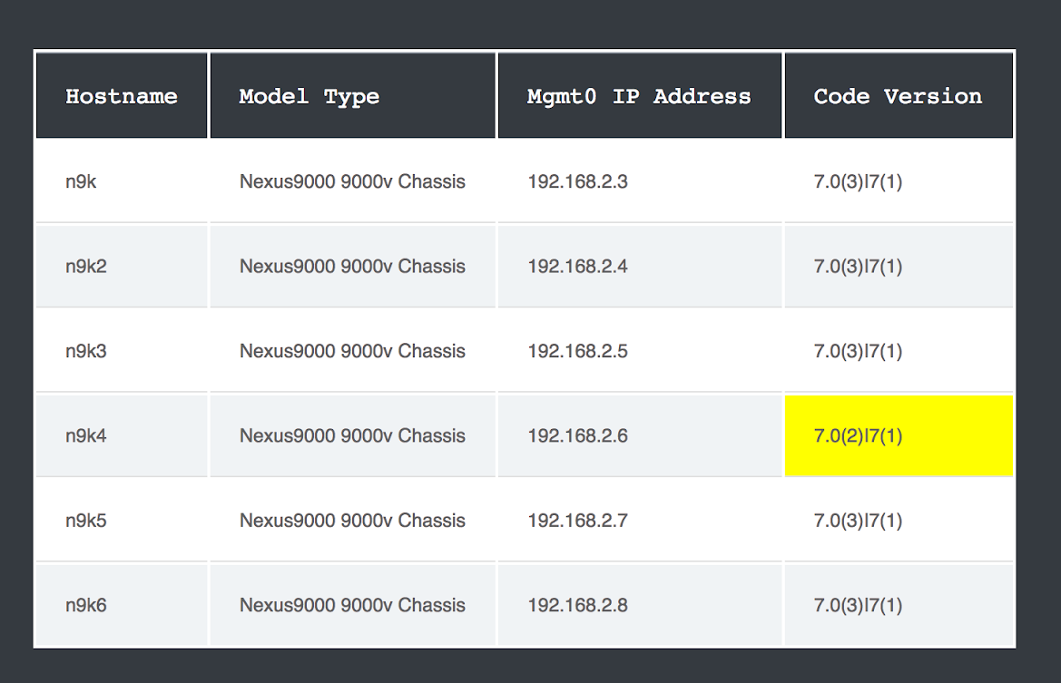
Build reports with Ansible Facts
Notes:
While we won’t cover creating this exact template in the workshop today, creating dynamic documentation is a very valid read-only Ansible Playbook where an organization can get value out of Ansible right away. In this example a user has 6 Cisco Nexus 9Ks and used Ansible facts to generate a report. With three tasks and a jinja2 template (we will cover Jinja in the next exercise), a network operator can easily see that the 4th Nexus 9k has a slightly different version number that the other network devices in his network. This type of dynamic documentation can be really helpful at being more proactive and catching something like this that would be really hard for a human operator to notice. Imagine if this network had hundreds of Nexus devices.
This github demonstration is available on our network-automation github organization: https://github.com/network-automation/ansible_inventory_report
Please join our community today! There are directions on the github organization.

Slide 78
Lab Time
Exercise 3 - Ansible Facts
red.ht/network-workshop-3
Demonstration use of Ansible facts on network infrastructure.
Approximate time: 15 mins

Slide 79
Section 4
Resource Modules
Ansible Network Automation Workshop
Topics Covered:
Resource modules
state: merged
state: gathered
Notes:
this section corresponds to exercise 3 in the lab guide https://ansible.github.io/workshops/exercises/ansible_network/3-facts/

Slide 80




Network Automation Modules
How do we interact with network devices?
command
run arbitrary commands
facts
retrieve information
config
generic catch-all configuration
and templating
resource
read and configure specific network resources
Notes:
partner
modules created and certified by a Red Hat Partner (e.g. F5)

Slide 81
Network Automation Modules
How do we interact with network devices?
command
namespace.collection.command Cisco IOS -> cisco.ios.command
facts
namespace.collection.facts
Arista EOS -> arista.eos.facts
namespace.collection.config
Juniper Junos-> junipernetworks.junos.config
config
namespace.collection.module
Cisco IOS-XR-> cisco.iosxr.acls
resource
Notes:
partner namespace.collection.module F5 BIG-IP -> f5networks.f5_modules.bigip_node

Slide 82



Network resource modules
Managing device state across different devices and types
Built-in logic with commands and orchestration
Configuration to code
Vendor-agnostic data model
Bidirectional with configuration to facts and facts to configuration
‹#›
Notes:
In this example we are using the network toolkit collection. We provide you a turnkey, multi-network backup role that you can simply call. This is 8 lines of YAML, that you can cut and paste and it will backup network configurations for hundreds and hundreds of network devices.

Slide 83
Lab Time
Exercise 4 - Ansible Network Resource Modules
red.ht/network-workshop-4
This exercise will cover configuring VLANs on Arista EOS by building an Ansible Playbook using the arista.eos.vlans module.
Approximate time: 15 mins

Slide 84
Section 5
Automation controller
Ansible Network Automation Workshop
Topics Covered:
What is Automation controller?
Enterprise Features
Notes:
this section corresponds to exercise 5 in the lab guide https://ansible.github.io/workshops/exercises/ansible_network/5-explore-controller/

Slide 85
What makes a platform?
On-premises
Ansible Cloud Services
Content creators
Automation controller
Automation
hub
Automation
services catalog
Insights for Ansible Automation Platform
Operators
Ansible content domains
Infrastructure
Cloud
Network
Security
Linux
Windows
Domain experts
Ansible command line
Users
Fueled by an open source community
Notes:
The architecture of the platform consists of a several core components, shown on the right, which are used by mentioned personas related to automation, indicated on the left.
Let’s have a closer look at the different parts, what they are made of, how they work with each other, from the perspective of the personas.

Slide 86
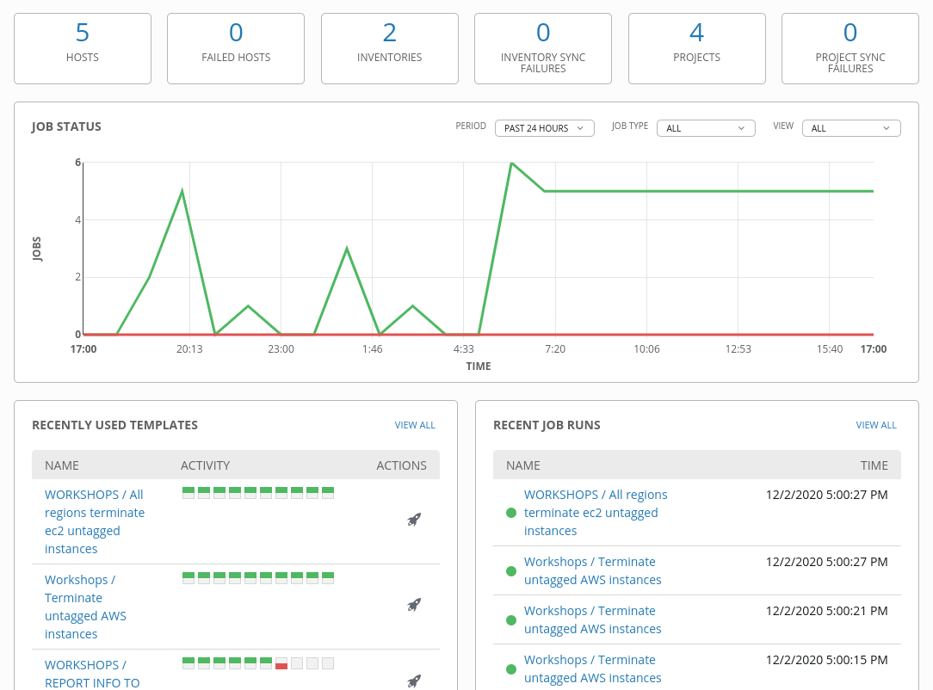
What is Ansible Automation Controller?
Ansible Automation Controller is a UI and RESTful API allowing you to scale IT automation, manage complex deployments and speed productivity.
Role-based access control
Deploy entire applications with push-button deployment access
All automations are centrally logged
Powerful workflows match your IT processes

Slide 87
Automation controller
Push button
RESTful API
RBAC
With an API first mentality every feature and function of controller can be API driven. Allow seamless integration with other tools like ServiceNow and Infoblox.
Allow restricting playbook access to authorized users. One team can use playbooks in check mode (read-only) while others have full administrative abilities.
An intuitive user interface experience makes it easy for novice users to execute playbooks you allow them access to.
Enterprise integrations
Centralized logging
Workflows
Integrate with enterprise authentication like TACACS+, RADIUS, Azure AD. Setup token authentication with OAuth 2. Setup notifications with PagerDuty, Slack and Twilio.
All automation activity is securely logged. Who ran it, how they customized it, what it did, where it happened - all securely stored and viewable later, or exported through Automation controllers API.
Automation controller’s multi-playbook workflows chain any number of playbooks, regardless of whether they use different inventories, run as different users, run at once or utilize different credentials.
Notes:
WORKFLOWS
Ansible Automation Controller’s multi-playbook workflows chain any number of playbooks, regardless of whether they use different inventories, run as different users, run at once or utilize different credentials.

Slide 88
Lab Time
Exercise 5: Explore Automation controller
red.ht/network-workshop-5
Explore and understand the Automation controller lab environment.
Approximate time: 15 mins

Slide 89
Section 6
Job Templates
Ansible Network Automation Workshop
Topics Covered:
Job Templates
Inventory
Credentials
Projects
Notes:
this section corresponds to exercise 5 in the lab guide https://ansible.github.io/workshops/exercises/ansible_network/6-controller-job-template/

Slide 90

Anatomy of an Automation Job
Playbook
Git / Subversion
Project
Notes:
What is anatomy of an automation job?
We start off with an Ansible playbook and create our first project. Projects are a logical collection of our Ansible playbooks.

Slide 91


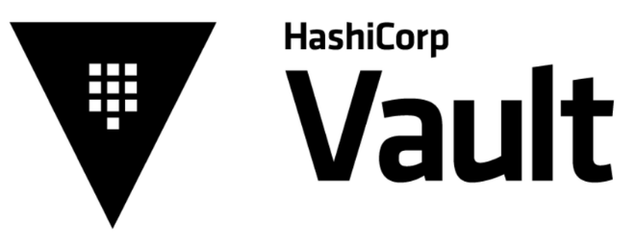
Anatomy of an Automation Job
Playbook
Git / Subversion
Project
Credential
Notes:
From our project, we then go off and create credentials. Credentials are utilized by Automation Controller for authentication with various external resources ( think ssh access to remote machines or access to network devices as examples). We can even encrypt those credentials using tools like Hashicorp Vault or Cyberark.

Slide 92




Anatomy of an Automation Job
Playbook
Git / Subversion
Project
Credential
Inventory
Notes:
We then create inventories to store a collection of hosts and can group them in order to connect and manage them.

Slide 93

Anatomy of an Automation Job
Playbook
Git / Subversion
Project
Credential
Inventory
Automation controller
Notes:
And Finally we allow Automation Controller to take all that information and run the job against the inventory hosts with the appropriate credentials in place.

Slide 94
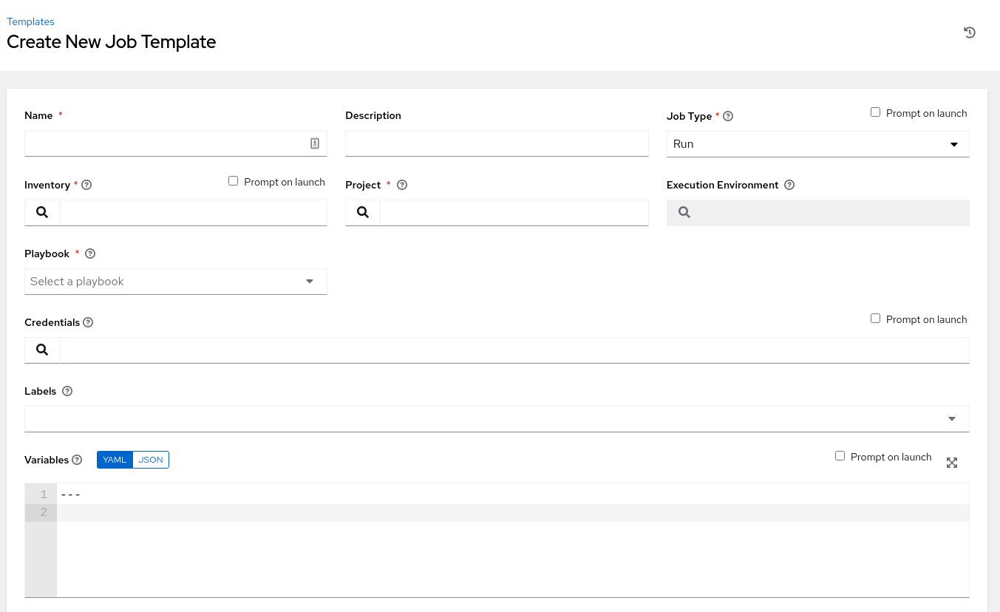
Job Templates
Everything in Automation Controller revolves around the concept of a Job Template. Job Templates allow Ansible Playbooks to be controlled, delegated and scaled for an organization. Job templates also encourage the reuse of Ansible Playbook content and collaboration between teams.
A Job Template requires:
A Project which contains Ansible Playbooks
An Inventory to run the job against
A Credential to login to devices.

Slide 95
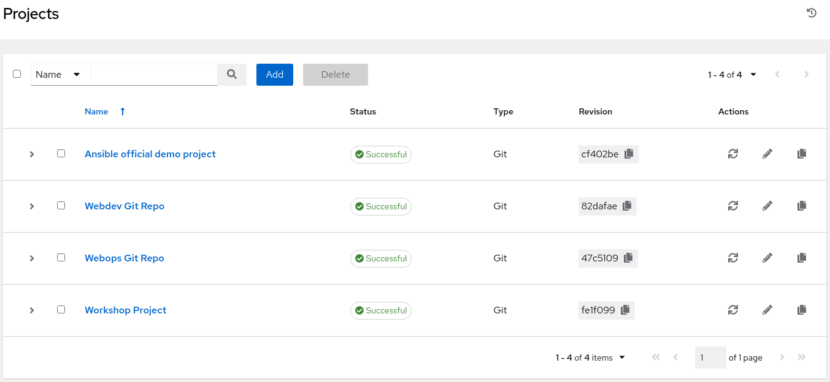
Project
A project is a logical collection of Ansible Playbooks, represented in Ansible Automation Controller.
You can manage Ansible Playbooks and playbook directories by placing them in a source code management system supported by Automation controller including Git, and Subversion.

Slide 96
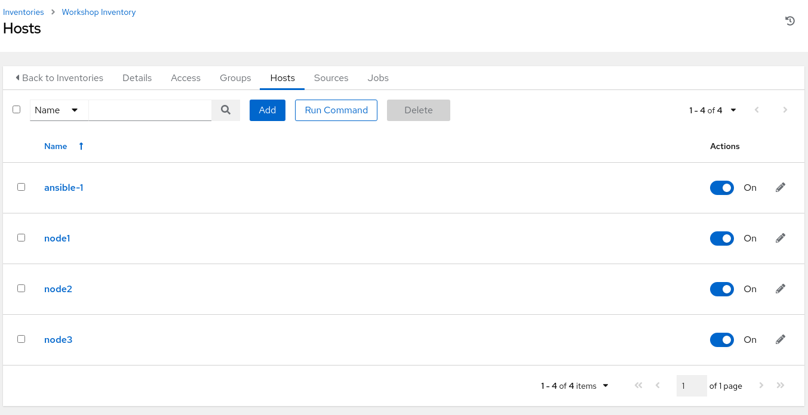
Inventory
Inventory is a collection of hosts (nodes) with associated data and groupings that Automation Controller can connect to and manage.
Hosts (nodes)
Groups
Inventory-specific data (variables)
Static or dynamic sources
Notes:
An Inventory is a collection of hosts against which jobs may be launched, the same as an Ansible inventory file. Inventories are divided into groups and these groups contain the actual hosts. Groups may be sourced manually, by entering host names into controller, or from one of Automation controller’s supported cloud providers.
Automation controller inventory is identical in behavior to the Ansible Engine cli. In fact for the workshop we used one command to import the workshop INI file into Automation controller. Check out this blog for more info: https://www.ansible.com/blog/three-quick-ways-to-move-your-ansible-inventory-into-red-hat-ansible-tower

Slide 97
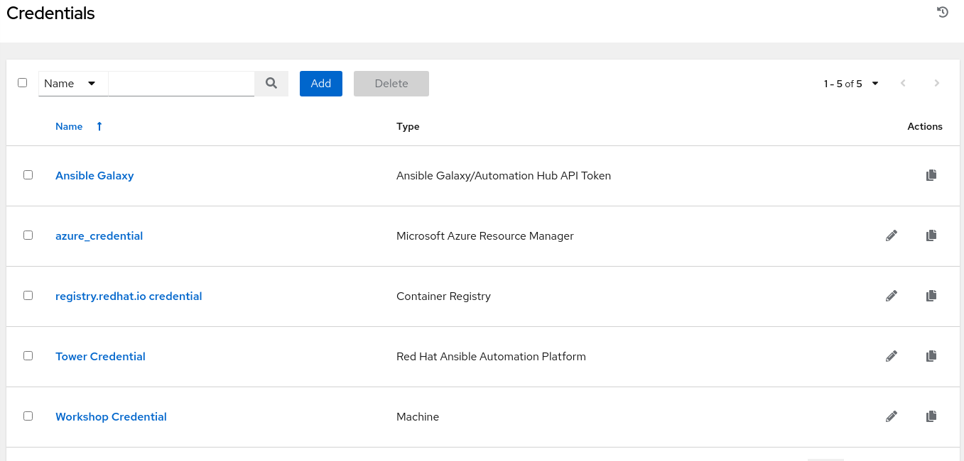
Credentials
Credentials are utilized by Automation Controller for authentication with various external resources:
Connecting to remote machines to run jobs
Syncing with inventory sources
Importing project content from version control systems
Connecting to and managing network devices
Centralized management of various credentials allows end users to leverage a secret without ever exposing that secret to them.
Notes:
Credentials can be a plain text password, an SSH key, a token or whatever the automated endpoint needs for authentication. Automation controller includes integrations with existing credential management tools such as HashiCorp Vault and CyberArk

Slide 98
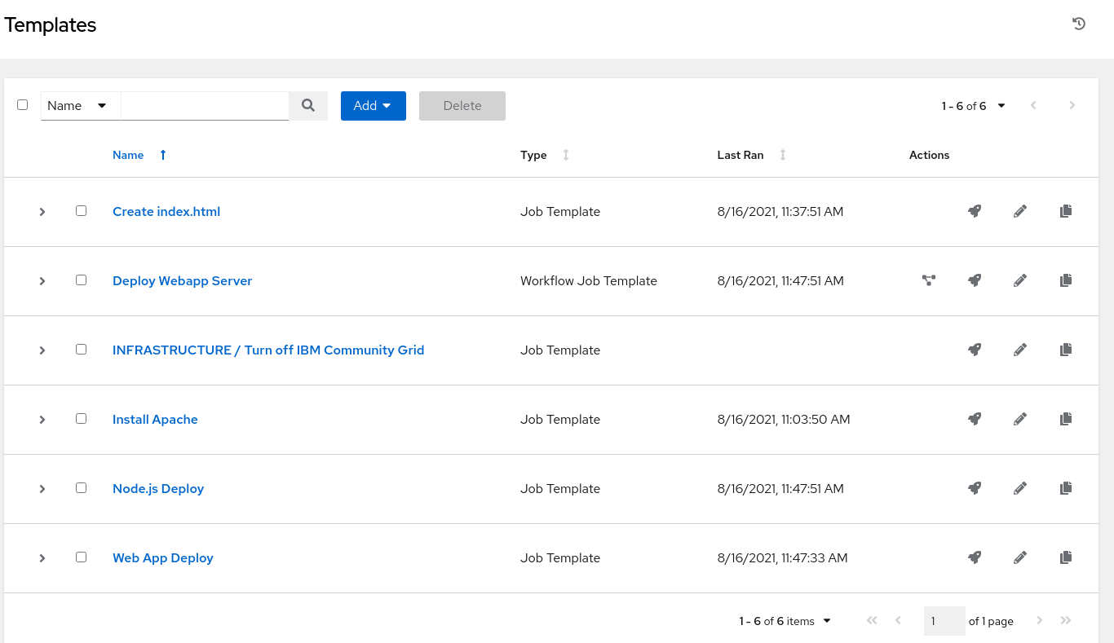
Expanding on Job Templates
Job Templates can be found and created by clicking the Templates button under the Resources section on the left menu.
Notes:
The job templates menu opens a list of the job templates that are currently available. The default view is collapsed (Compact), showing the template name, template type, and the statuses of the jobs that ran using that template, but you can click Expanded to view more information. This list is sorted alphabetically by name, but you can sort by other criteria, or search by various fields and attributes of a template.

Slide 99

Executing an existing Job Template
Job Templates can be launched by clicking the rocketship button for the corresponding Job Template
Notes:
A major benefit of Automation controller is the push-button deployment of Ansible playbooks. You can easily configure a template within controller to store all parameters you would normally pass to the ansible-playbook on the command line–not just the playbooks, but the inventory, credentials, extra variables, and all options and settings you can specify on the command line. Easier deployments drive consistency, by running your playbooks the same way each time, and allow you to delegate responsibilities–even users who aren’t Ansible experts can run controller playbooks written by others.

Slide 100
Creating a new Job Template (1/2)
New Job Templates can be created by clicking the Add button

Slide 101
Creating a new Job Template (2/2)
This New Job Template window is where the inventory, project and credential are assigned. The red asterisk * means the field is required .
Notes:
To choose the Ansible Playbook a Project must be assigned. This menu is automatically populated with the names of the playbooks found in the project base path for the selected project.

Slide 102
Lab Time
Exercise 6: Creating an Automation controller Job Template
red.ht/network-workshop-6
Demonstrate a network backup configuration job template with Automation controller.
Approximate time: 15 mins

Slide 103
Section 7
Survey
Ansible Network Automation Workshop
Topics Covered:
Understanding Extra Vars
Building a Survey
Self-service IT with Surveys
Notes:
this section corresponds to exercise 5 in the lab guide https://ansible.github.io/workshops/exercises/ansible_network/7-controller-survey/

Slide 104

Surveys
Controller surveys allow you to configure how a job runs via a series of questions, making it simple to customize your jobs in a user-friendly way.
An Ansible Controller survey is a simple question-and-answer form that allows users to customize their job runs. Combine that with Controller’s role-based access control, and you can build simple, easy self-service for your users.
Notes:
Surveys allow you to create variables for use within an Ansible Playbook through an easy to use web form, very similar to Google forms or Survey Monkey. It is intuitive and easy for a non-technical users to fill out. Answers to the survey can be provided in text, text area, password (hidden), multiple choice (single select), multiple choice (multiple select), integer and a float. This allows a lot of flexibility in forcing the user experience to be very prescriptive or flexible.

Slide 105
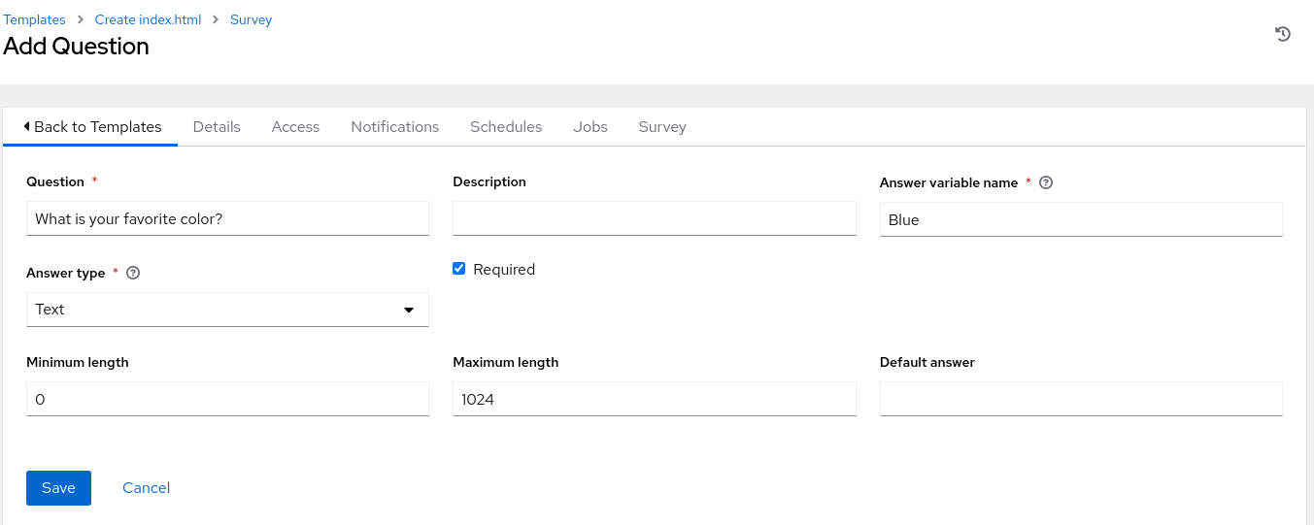
Creating a Survey (1/2)
Once a job template is saved, the survey menu will have an Add button Click the button to open the Add Survey window.
Notes:
The job templates menu opens a list of the job templates that are currently available. The default view is collapsed (Compact), showing the template name, template type, and the statuses of the jobs that ran using that template, but you can click Expanded to view more information. This list is sorted alphabetically by name, but you can sort by other criteria, or search by various fields and attributes of a template.

Slide 106
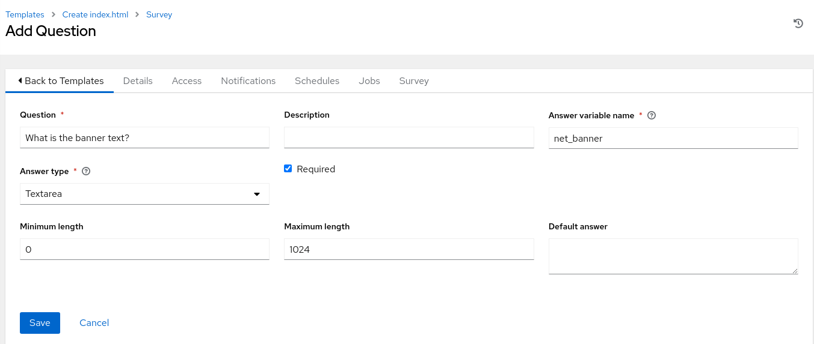
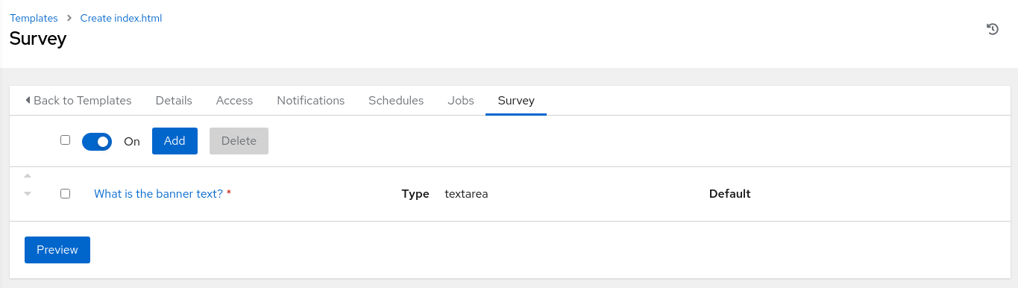
Creating a Survey (2/2)
The Add Survey window allows the job template to prompt users for one or more questions. The answers provided become variables for use in the Ansible Playbook.
Notes:
In the exercise the variable net_banner will be used, which is used in the Ansible Playbook to push a banner to network devices.

Slide 107
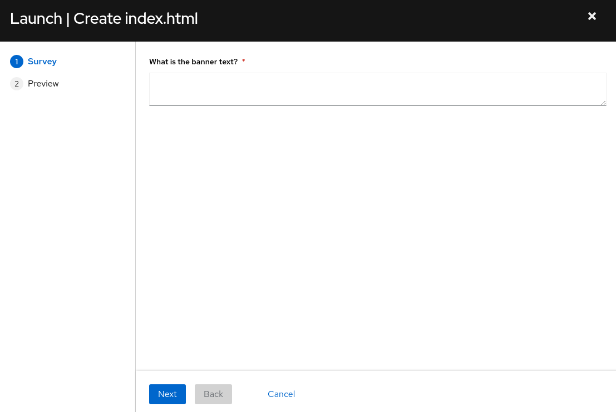
Using a Survey
When launching a job, the user will now be prompted with the survey. The user can be required to fill out the survey before the job template will execute.
Notes:
In the exercise the variable net_banner will be used, which is used in the Ansible Playbook to push a banner to network devices.

Slide 108
Lab Time
Exercise 7: Creating a Survey
red.ht/network-workshop-7
Demonstrate the use of Automation controller survey feature.
Approximate time: 15 mins

Slide 109
Section 8
RBAC
Ansible Network Automation Workshop
Topics Covered:
Understanding Organizations
Understanding Teams
Understanding Users
Notes:
this section corresponds to exercise 8 in the lab guide https://ansible.github.io/workshops/exercises/ansible_network/8-controller-rbac/

Slide 110
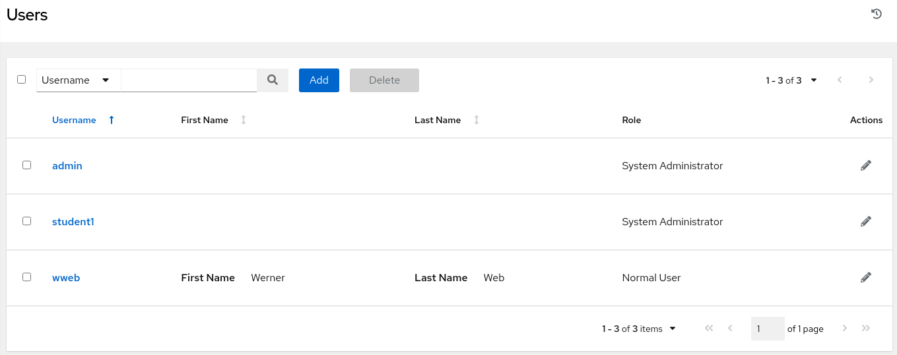
Role-based access control
How to manage access
Role-based access control system: Users can be grouped in teams, and roles can be assigned to the teams.
Rights to edit or use can be assigned across all objects.
All backed by enterprise authentication if needed.
Notes:
Access to the automation content can be limited to only what a consumer needs. The Automation controller UI offers role based access control: people can be grouped in teams, and roles can be assigned to these groups. Permissions can be granted or denied to almost all objects, such as jobs and credentials
Additionally, a predefined ‘Auditor’ role is available who can see all aspects of the systems automation, but has no permission to run or change automation, for those that need a system-level auditor.
This all is backed by enterprise authentication: the Automation controller authentication can be connected to AD and other enterprise tools, the groups and roles can be mapped accordingly.
Value: Proper roles system eases governance of access and execution
Example: Security team onboards a new team member. That one is added to the security team group in AD, and thus automatically inherits the same rights as the others. Part of these rights is to see and execute, but not change the automation jobs from the IT OPS teams.
Ending question: Glad to hear that the access can be limited. But what about governance? How can I control how many resources someone accesses? After all, automation is great, but it should not get out of hand!

Slide 111
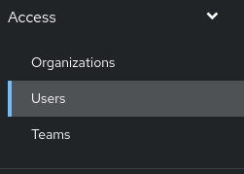
User Management
An organization is a logical collection of users, teams, projects, inventories and more. All entities belong to an organization.
A user is an account to access Ansible Automation Controller and its services given the permissions granted to it.
Teams provide a means to implement role-based access control schemes and delegate responsibilities across organizations.
Notes:
RBACs are easiest to think of in terms of Roles which define precisely who or what can see, change, or delete an “object” for which a specific capability is being set. RBAC is best thought of as granting roles to users or teams.

Slide 112
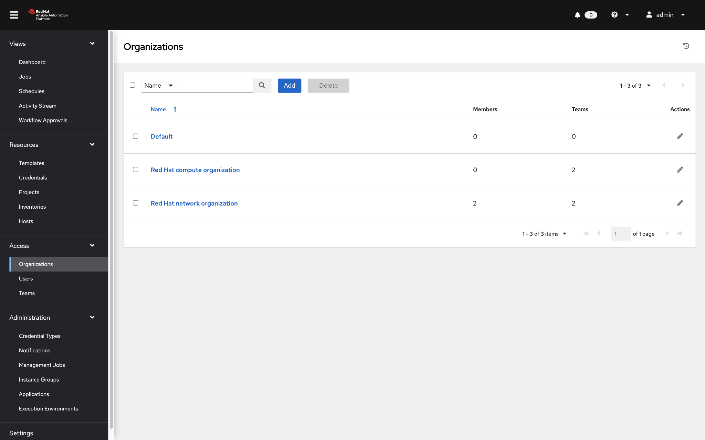
Viewing Organizations
Clicking on the Organizations button in the left menu will open up the Organizations window
Notes:
For the network automation workshop we have three organizations, Default, REDHAT COMPUTE ORGANIZATION and REDHAT NETWORK ORGANIZATION.

Slide 113
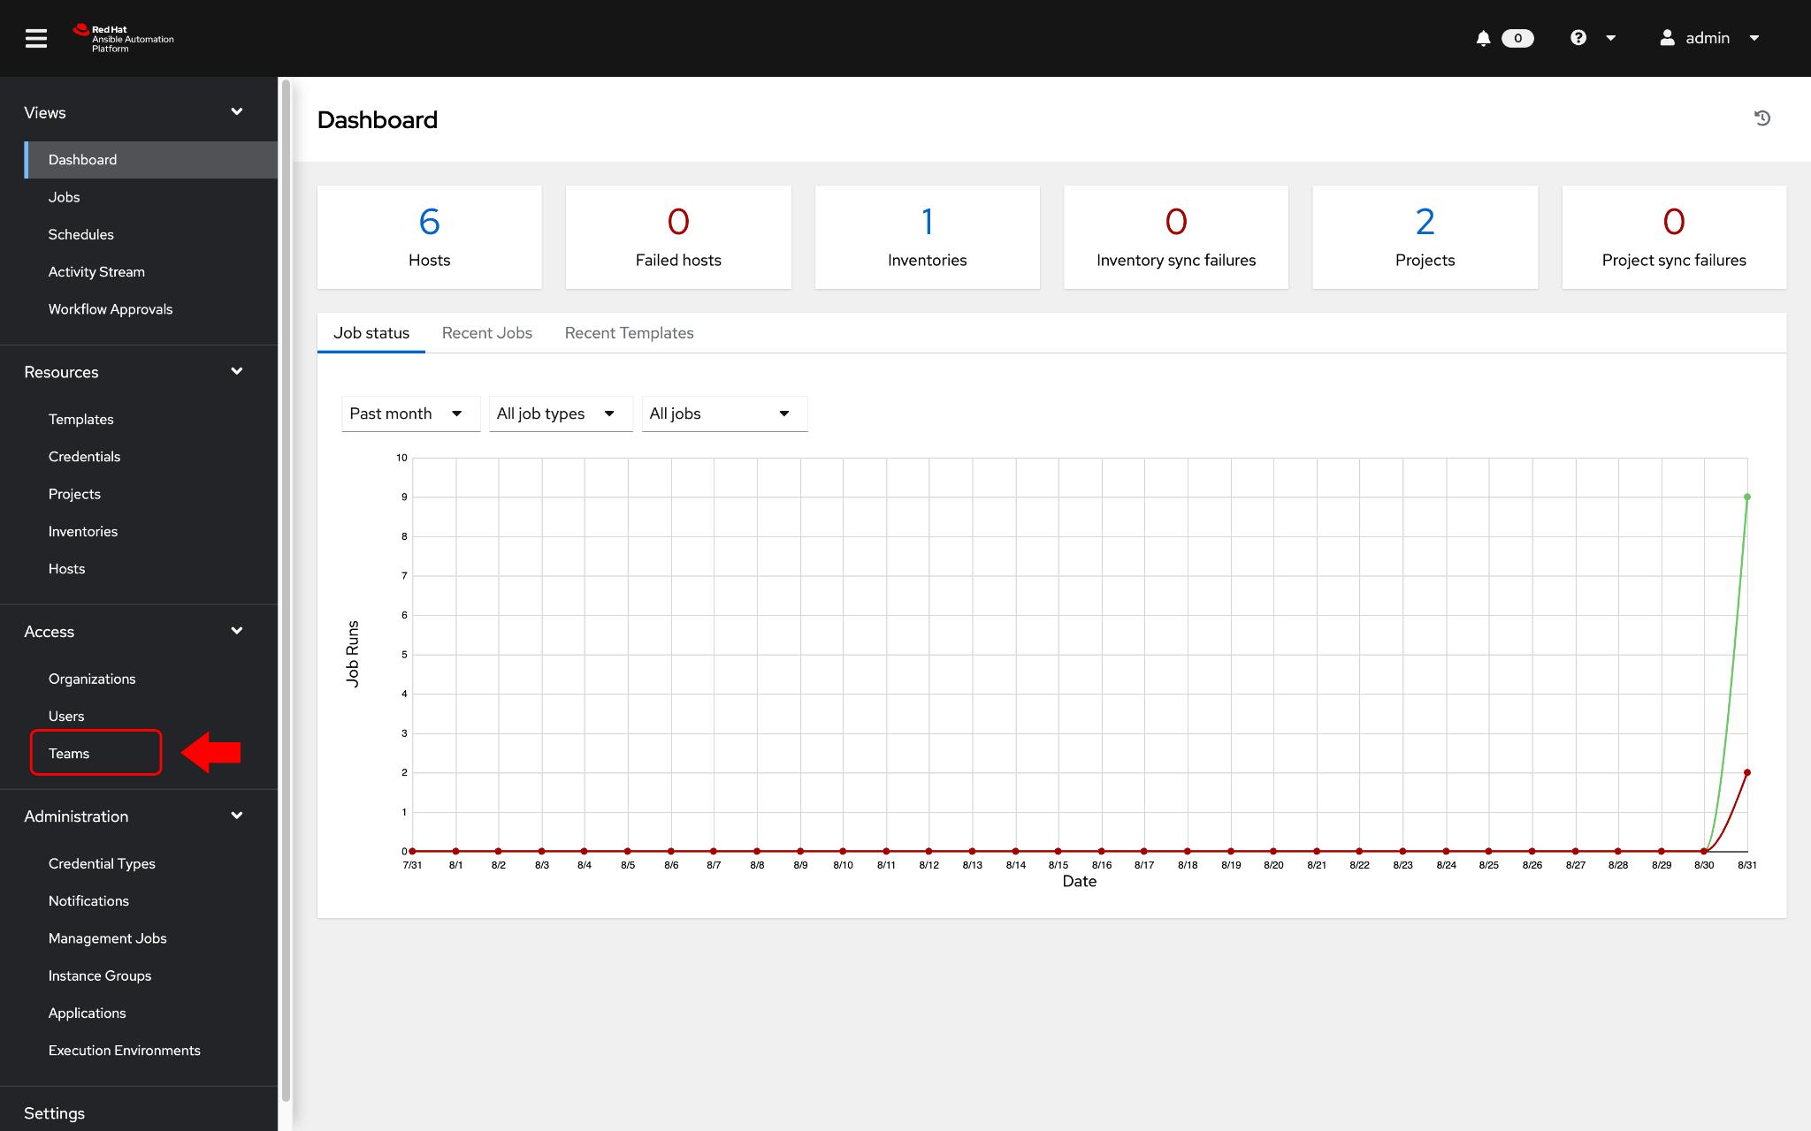
Viewing Teams
Clicking on the Teams buttons in the left menu will open up the Teams window
Notes:
For the network automation workshop we have pre-provisioned fours teams, Compute T1, Compute T2, Netadmin and Netops. This is just an example for this workshop to show what is possible with teams and associated roles for those teams.

Slide 114
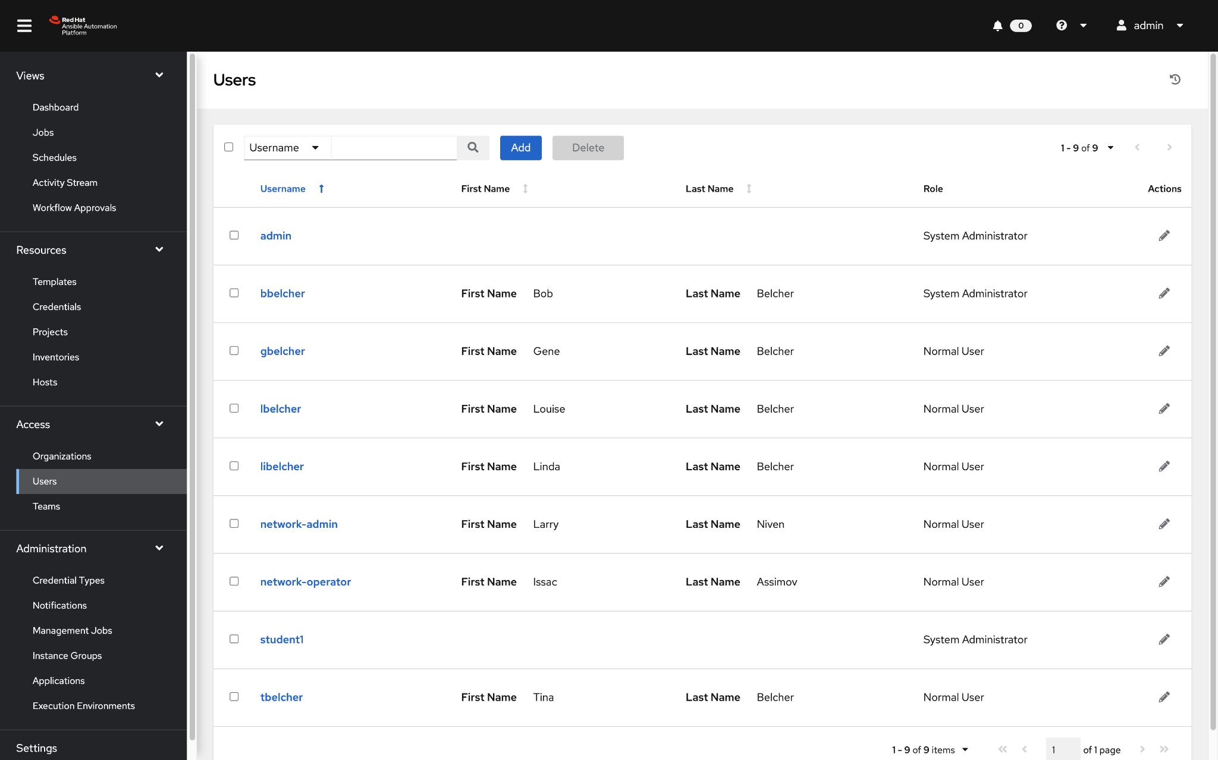
Viewing Users
Clicking on the Users button in the left menu will open up the Users window
Notes:
For the network automation workshop we have pre-provisioned a bunch of users. The users we will focus on for the exercise will be network-admin and network-operator.

Slide 115
Lab Time
Exercise 8: Understanding RBAC in Automation controller
red.ht/network-workshop-8
Demonstrate the use of role based access control on Automation controller.
Approximate time: 15 mins

Slide 116
Section 9
Workflows
Ansible Network Automation Workshop
Topics Covered:
Understanding Workflows
Branching
Convergence / Joins
Conditional Logic
Notes:
this section corresponds to exercise 9 in the lab guide https://ansible.github.io/workshops/exercises/ansible_network/9-controller-workflow/

Slide 117
Lab Time
Exercise 9: Creating a Workflow
red.ht/network-workshop-9
Demonstrate the use of Automation Controller workflow. Workflows allow you to configure a sequence of disparate job templates (or workflow templates) that may or may not share inventory, playbooks, or permissions.
Approximate time: 15 mins

Slide 118
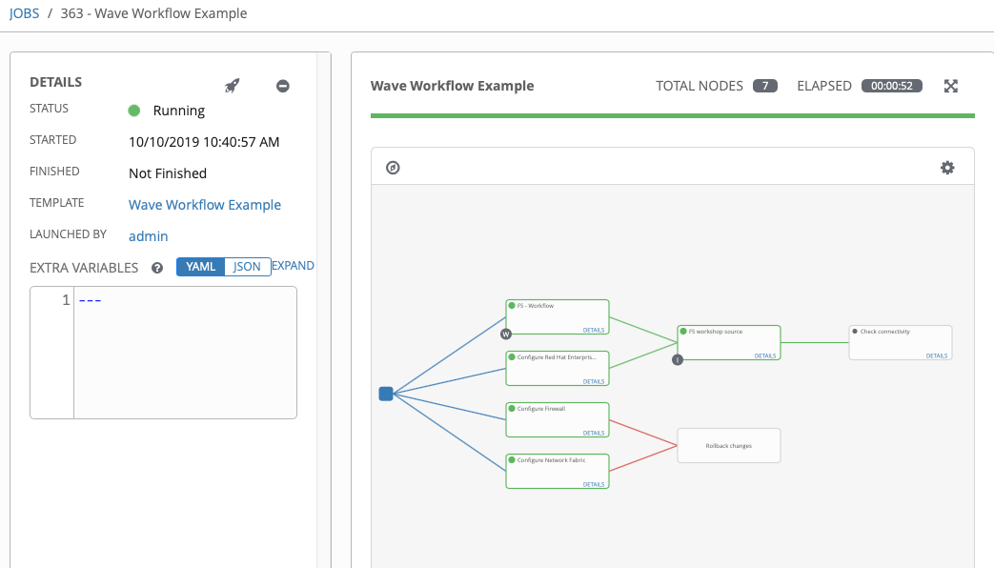
Workflows
Combine automation to create something bigger
Workflows enable the creation of powerful holistic automation, chaining together multiple pieces of automation and events.
Simple logic inside these workflows can trigger automation depending on the success or failure of previous steps.
Notes:
Workflows allow users to chain together disparate jobs in Automation controller together. They are linked together using a graph-like structure that can be modified in a visual editor. This provides a holistic overview of the automation and enables to stitch together automation code from different teams, including the ability to fork tasks to run simultaneously and logic for handling successful and failed outcomes.
Value: Orchestration across multiple automation jobs, even from different teams.
Example: The storage, the networking team and the ops team all have their own automation code in their own repositories. To bring all their code for a complex deployment together, the deployment is layed out via a workflow, enabling to start the complex process across multiple teams with one click.
Ending question: So we now how to execute automation, even across teams. But how do we integrate it with other tools? With the monitoring for example?

Slide 119
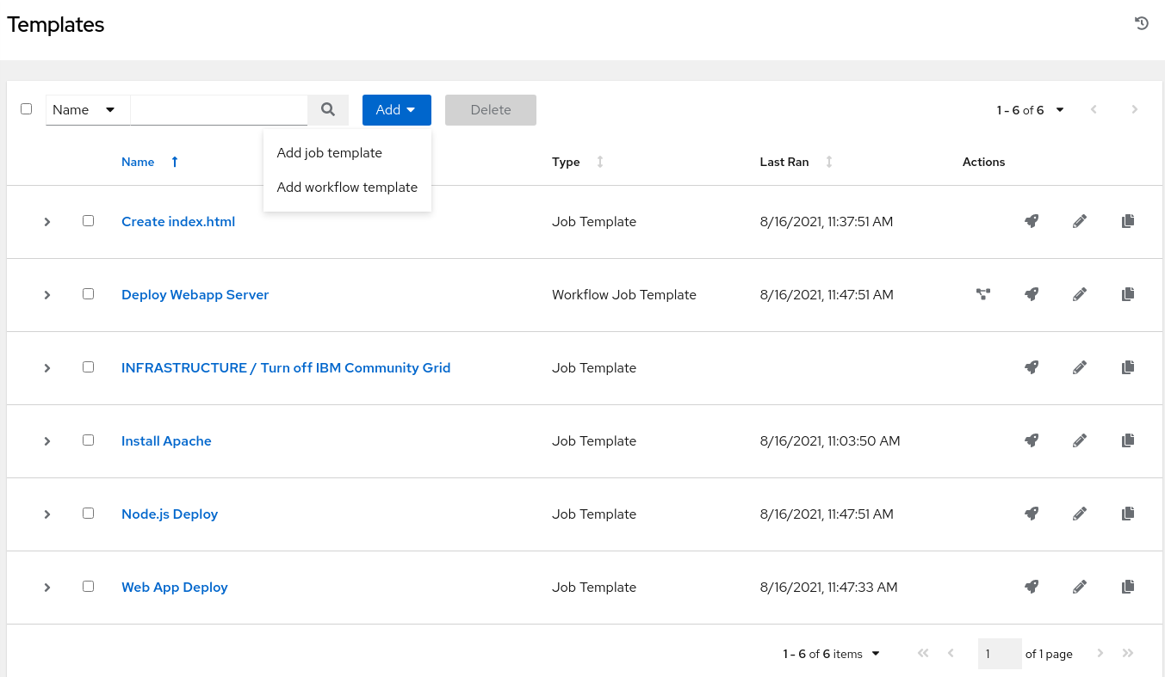
Adding a New Template
To add a new Workflow click on the Add button. This time select the Add workflow template

Slide 120
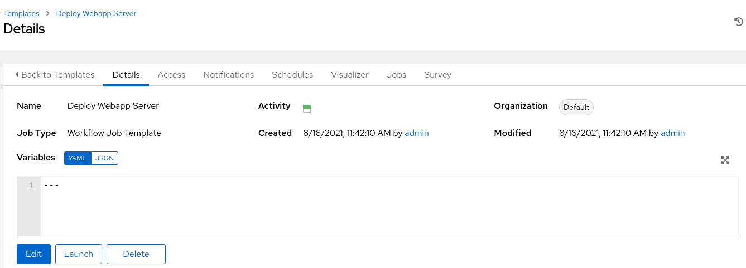
Creating the Workflow
Fill out the required parameters and click Save. As soon as the Workflow Template is saved the Workflow Visualizer will open.
Notes:
If you click save and the workflow visualizer doesn’t open, or you accidentally click on another window, simply click back to the WORKSHOP WORKFLOW template (or whatever you named it) and the blue button WORKFLOW VISUALIZER button will now no longer be grayed out and you can click on it to open this window.

Slide 121
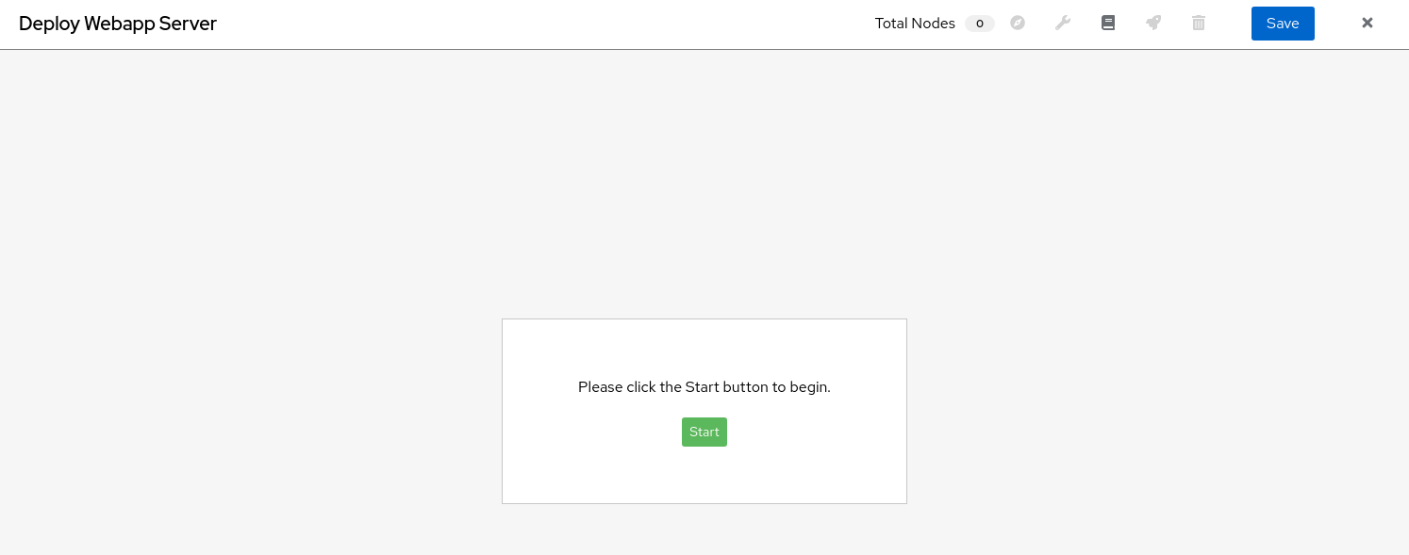
Workflow Visualizer
The Workflow Visualizer will start as a blank canvas.
Click the green Start button to start building the workflow.
Notes:
Click on the START button to add your first Job Template. Make sure to click SAVE and not the CLOSE button or you will lose your work.

Slide 122

Ansible Automation Platform
Using workflows to enhance your automation
WORKFLOW VISUALIZER | Operational State Workflow
Check Operational State
Update SOT
JT
JT
START
Backup Configs
Deploy Configuration
Restore Config
JT
JT
JT
Notes:
Operational state can add another level of confidence that automation did what it was supposed to do. This is an example using the workflow feature that is part of Automation controller. This allows a user to create a workflow of multiple job template (or even other workflows to create nested workflows).
In this example a network automation operator can backup configurations (if necessary) before any other automation takes place, creating safe guards for adopting automation. The green lines indicate “run this job if the previous one is successful”. The red lines indicate “run this job if the previous automation job fails”. This allows the workflow to revert back to a working (or at least pervious to when automation was deployed). An operational deployment automation job could be deployed as part of success criteria (e.g. a large route change is automated, but it didn’t do as expected, revert to known stable and alert the operator).
Workflows allow automation authors to create succinct automation jobs that do something really well, and stitch them together into different scenarios to do more complex orchestration. This example is showing just a network, but you can now daisy chain this entire workflow as a nested workflow for something like application deployment. This allows IT operators to begin thinking of outcomes versus individual technology silos, and allows domain architects to hand processes in an automated manner to other teams (e.g. the network team says this happens this way when we deploy a new application/subnet/vlan/etc).

Slide 123
Wrapping up
Ansible Network Automation Workshop
Topics Covered:
Next Steps
Chat with us
Consulting Services

Slide 124
Where to go next
Learn more
Workshops
Documents
Youtube
Twitter
Get started
Evals
cloud.redhat.com
Get serious
Red Hat Automation Adoption Journey
Red Hat Training
Red Hat Consulting
Notes:
These are the options to get you started!

Slide 125
Chat with us
Slack https://ansiblenetwork.slack.com Join by clicking here http://bit.ly/ansibleslack
IRC #ansible-network on freenode http://webchat.freenode.net/?channels=ansible-network
Notes:
For the network automation workshop we have three organizations, Default, REDHAT COMPUTE ORGANIZATION and REDHAT NETWORK ORGANIZATION.
the full slack URL is https://join.slack.com/t/ansiblenetwork/shared_invite/enQtNTU4ODIyNzA1MDkyLThiYmQ3MmNkMWRmOTdjYjMxNzdlNDc4OTk5YTc1ZDBiNDAwOTZlZjE0NDliODJiMjJhMDBkZWM4Nzg2NjkzNDA

Slide 126
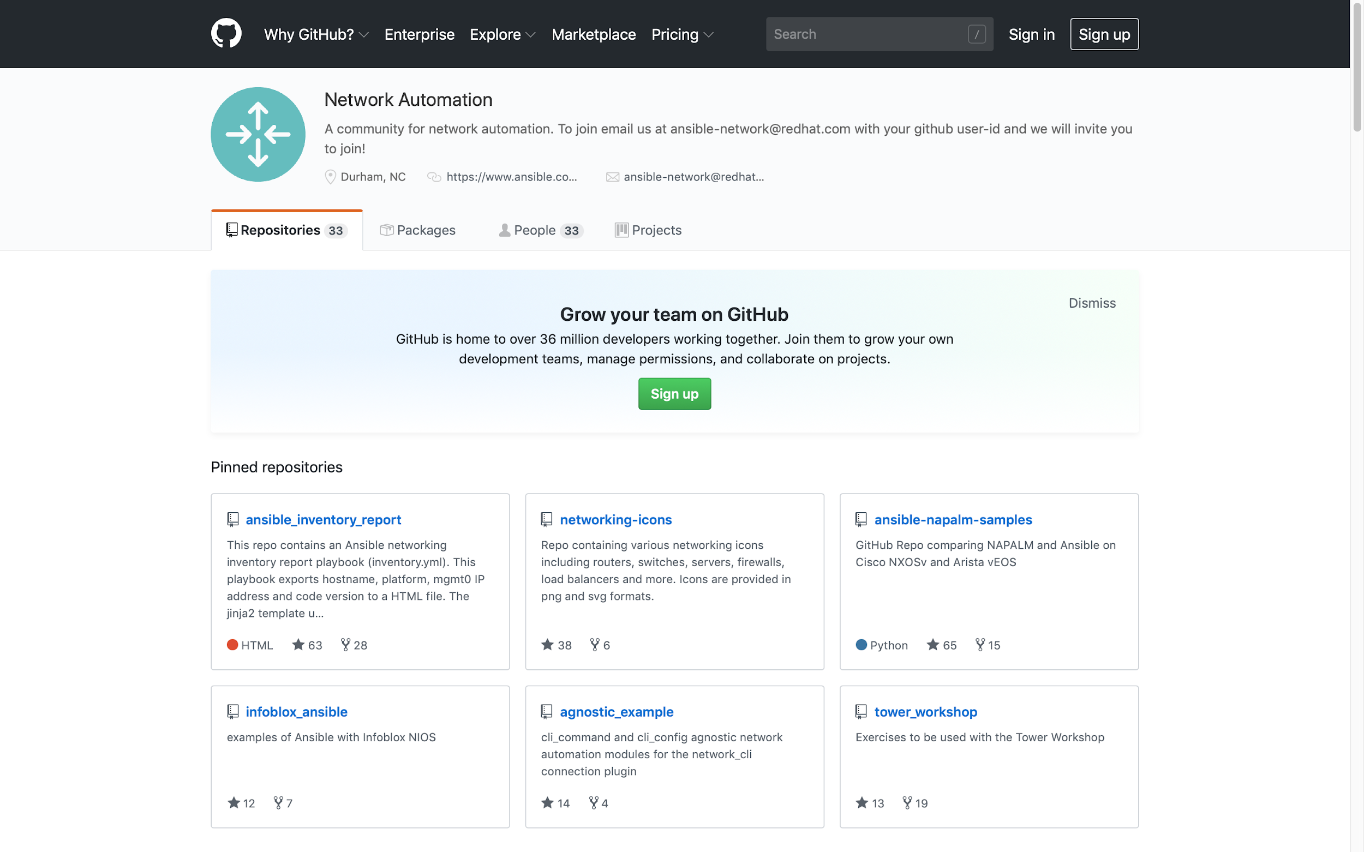
Bookmark the Github organization
Examples, samples and demos
Run network topologies right on your laptop
Notes:
For the network automation workshop we have three organizations, Default, REDHAT COMPUTE ORGANIZATION and REDHAT NETWORK ORGANIZATION.

Slide 127



Red Hat Services
Accelerate standardization and automation of network configuration
 | Challenge |  | Approach |  | Benefits
Slow
Time consuming, labor intensive procedures to propagate network changes
Automate
Encode and execute procedures with human-readable Ansible playbooks
Speed
Reduce changes from days to hours and drive simultaneous config across 100s of endpoints
Chaos
Rising number of devices, environments, and vendor-specific tooling create sprawl and skills gaps
Standardize
Automate common tasks using Ansible modules to abstract vendor-specific details
Efficiency
Easily combine and execute complex configuration procedures across environments
Errors
Over time, vulnerabilities, patches, and mistakes undermine known-good configurations.
Test
Iteratively refine and validate provisioning and configuration pre-PROD
Reliability
Eliminate human error in production changes
Mystery
No living source of truth for which patches, packages, or configurations are deployed where
Catalog
Automate configuration reporting, inventory, and change tracking across all environments
Manageability
Centrally track and manage configuration rollout, drift, patching, and compliance
Notes:
Red Hat Services can help you accelerate your network automation projects and quicken your time-to-value with Ansible through training, consulting, and mentoring.
Red Hat Services solutions are tailored to meet you where you are, whether you’re wanting to
standardize and accelerate device provisioning and configuration across vendors
automate IPAM and DNS management
centrally manage load and ACL
mature network-as-code practices,
or any combination thereof.
Red Hat training and consulting services empower your team to innovate and automate increasingly complex workflows and systems as you continue your journey to automate the enterprise.

Slide 128
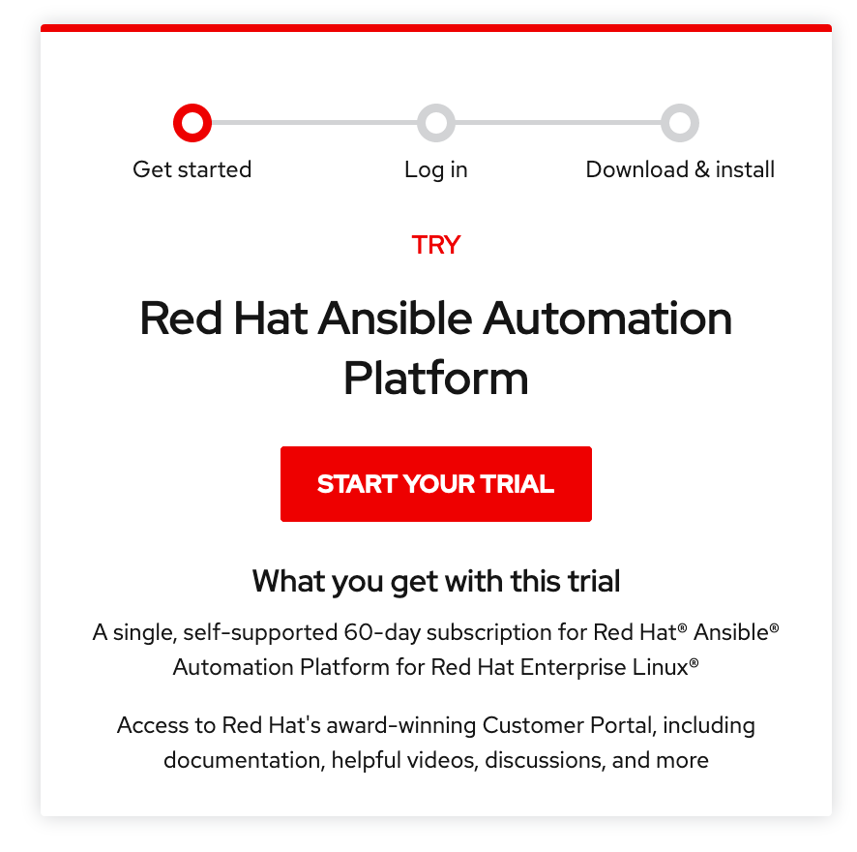
Resources
Network automation for everyone (Overview)
Automate your network with Red Hat (Technical)
Online training: Red Hat Ansible for Network Automation
Network Automation web page
Red Hat Ansible Automation Platform blog
red.ht/ansible_trial
Notes:
Here are some resources that you can use to learn more about Network Automation with Ansible Automation Platform. We encourage you to download the trial so your teams can see this automation in a hands-on way.

Slide 129
Thank you

Slide 130
Supplemental
Ansible Network Automation Workshop
Topics Covered:
Understand group variables
Understand Jinja2
cli_config module

Slide 131
Group variables
Group variables are variables that are common between two or more devices. Group variables can be associated with an individual group (e.g. “cisco”) or a nested group (e.g. routers).
Examples include
NTP servers
DNS servers
SNMP information
Basically network information that is common for that group
Notes:
For all Ansible devices there is host_vars or variables specific to an individual host, or group variables that are variables specific to one or more devices. Variables have a well documented hierarchy with examples of how Ansible users store their variables.

Slide 132
Inventory versus group_vars directory
Group variables can be stored in a directory called group_vars in YAML syntax. In exercise one we covered host_vars and group_vars with relationship to inventory. What is the difference?
inventory
group_vars
Can be used to set variables to connect and authenticate to the device. Examples include:
Connection plugins (e.g. network_cli)
Usernames
Platform types (ansible_network_os)
Can be used to set variables to configure on the device. Examples include:
VLANs
Routing configuration
System services (NTP, DNS, etc)
Notes:
There are many places that variables can be stored with Ansible, but the most common are host_vars and group_vars directory. For this workshop we are going to show case and do an exercise with group_vars. It is important to understand that we already show cased host_vars and group_vars within our Ansible inventory in section one. With respect to functionality you could store all your variables in either place and only have the names within your inventory and it would work. Variables can be stored in any valid location and work. It is recommended by the Ansible team to store variables in a logical way that other users can quickly understand what you are doing and where variables are stored.
In general the only variables stored within Ansible Inventory are variables used to connect to the device such as the IP address of the device, connection plugin, username, etc.
For group_vars directory structure these variables are key,value pairs that are used to configure the device. This includes anything that would end up in the running configuration of the network devices such as VLANs, routing configuration, SNMP config, etc.

Slide 133
Examining a group_vars file
At the same directory level as the Ansible Playbook create a folder named group_vars. Group variable files can simply be named the group name (in this case all.yml)
$ cat group_vars/all.yml
nodes:
rtr1:
Loopback100: "192.168.100.1"
rtr2:
Loopback100: "192.168.100.2"
rtr3:
Loopback100: "192.168.100.3"
rtr4:
Loopback100: "192.168.100.4"
Notes:
Group variables are simply key,value pairs that are pieces of structured information that we can use to check on the configuration of, or configure a network device. In this example the Loopback100 could be stored in host_vars file unique per device but then we would have 10 files if we have 10 routers. Ideally the least amount of files and variables stored the better.

Slide 134

Jinja2
Ansible has native integration with the Jinja2 templating engine
Render data models into device configurations
Render device output into dynamic documentation
Jinja2 enables the user to manipulate variables, apply conditional logic and extend programmability for network automation.
Notes:
Jinja2 is a modern and designer-friendly templating language for Python, modelled after Django’s templates. It widely used by companies and organizations like Mozilla, SourceForge, Instagram and NPR.

Slide 135

Network Automation config modules
cli_config (agnostic)
ios_config:
nxos_config:
iosxr_config:
eos_config .
.
*os_config:
Variables
Template
Notes:
At a high level the process for creating device configurations simply takes your variables, uses them in a Jinja2 template, and renders device configuration.
There are some quick takeaways:
Anything can be automated that a human can configure on that device, as long as there is a config module for that platform, or it is supported by cli_config or other agnostic configuration modules.
cli_config is only for network_cli, the platform specific modules are great for taking advantage of platform specific features. For example Arista EOS can take advantage of the eos_config module using the httpapi connection plugin, because Arista has the eAPI built into their platform of devices. The Cisco NX-OS nxos_config module can also take advantage of the httpapi connection plugin using the Cisco NX-API.
The largest takeaway here is that two things (variables + template) can generate 3 or more rendered configurations. This is how you scale, and how automation acts a force multiplier to get lots of work done quickly. Even without pushing to configurations you can render the configs locally and replace clunky tools like using spreadsheets to render device configs.

Slide 136
Jinja2 Templating Example (1/2)
Variables
Jinja2 Template
ntp_server: 192.168.0.250
name_server: 192.168.0.251
!
ntp server {{ntp_server}}
!
ip name-server {{name_server}}
!
Generated Network Configuration
rtr1
rtrX
!
ip name-server 192.168.0.251
!
ntp server 192.168.0.250
!
!
ip name-server 192.168.0.251
!
ntp server 192.168.0.250
!
Notes:
Here is a very simple example with two variables being rendered.
In the top left is the group_vars file. This is the data model, or the way we are storing our variables. In general the more simple the data model, the easier it is for others to understand and use your work. Data models become important when two or more people start working on the same Ansible Playbook. In this data model we have a nodes key that contain four routers, rtr1 through rtr4. Each router has a Loopback 100 interface named Loopback100.
In the top right corner there is the Jinja2 template. This template simply renders a partial device configuration for the DNS server and the NTP server using our variables. The curly brackets will allow us to replace that spot with the actual variable.
Below is the rendered configuration. These two commands will be pushed to the device in configure mode. This example is showcasing syntax for Cisco IOS and Arista EOS. The templates would changed based on the underlying network operating system.

Slide 137
Jinja2 Templating Example (2/2)
Variables
Jinja2 Template
nodes:
rtr1:
Loopback100: "192.168.100.1"
rtr2:
Loopback100: "192.168.100.2"
rtr3:
Loopback100: "192.168.100.3"
rtr4:
Loopback100: "192.168.100.4"
{% for interface,ip in nodes[inventory_hostname].items() %}
interface {{interface}}
ip address {{ip}} 255.255.255.255
{% endfor %}
Generated Network Configuration
rtr1
rtr2
rtrX
interface Loopback100
ip address 192.168.100.1
!
interface Loopback100
ip address 192.168.100.2
!
interface Loopback100
ip address X
!
Notes:
We will walk through this example quickly. This example will go into more detail with exercise 4 where you will get to perform this exact scenario.
Again, the top left is our data model. In this data model we have a nodes key that contain four routers, rtr1 through rtr4. Each router has a Loopback 100 interface named Loopback100.
In the top right corner there is the Jinja2 template. This template example loops through each router and applies the interface configuration.
Pieces of code in a Jinja template are escaped with `{%` and `%}`.
The `interface,ip` breaks down the dictionary into a key named `interface` and a value named `ip`.
The `nodes[inventory_hostname]` does a dictionary lookup in the `group_vars/all.yml` file. The inventory_hostname is the name of the hostname as configured in Ansible's inventory host file. When the playbook is executed against `rtr1` inventory_hostname will be `rtr1`, when the playbook is executed against `rtr2`, the inventory_hostname will be `rtr2` and so forth.
Below is the rendered configuration for rtr1, rtr2 and so on and so forth. Two files can make infinite files depending on the size of the network!

Slide 138
The cli_config module
Agnostic module for network devices that uses the network_cli connection plugin.
---
- name: configure network devices
hosts: rtr1,rtr2
gather_facts: false
tasks:
- name: configure device with config
cli_config:
config: "{{ lookup('template', 'template.j2') }}"
Notes:
There are config modules for each network platform, but for this example we are going to use the agnostic module cli_config. This example will work the same on Arista EOS as it will Cisco IOS since those two operating system have identical commands for this particular scenario.
The word lookup in here is a keyword to tell us this is using the loopup plugin.
Lookup plugins allow Ansible to access data from outside sources. This can include reading the filesystem in addition to contacting external datastores and services. Like all templating, these plugins are evaluated on the Ansible control machine, not on the target/remote.
The data returned by a lookup plugin is made available using the standard templating system in Ansible, and are typically used to load variables or templates with information from those systems.
Lookups are an Ansible-specific extension to the Jinja2 templating language.
In this scenario we are telling the config parameter to do a lookup and use Jinja2 templating with the file template.j2. This will render the device configuration and push it to the targeted hosts (in this case rtr1 and rtr2).

